Slide 1
Data Science
Prathamesh Joshi

Slide 2
Classification
Prathamesh Joshi

Slide 3
Lab
To create side by side boxplots, we can try the function catplot from seaborn package.
It is very important to scale both training and test data in the same way
line plot for each row's data completeness. In this dataset, all rows have 4 - 8 valid values – check on manual data
10 test sets in 10-fold cross validation?-aggregate (mean, sum)
Bayes classifier with kNN
Curse of dimensionality: Nonparametric, discriminative, simple and complex models, when classes/ predictors increase
As we have sufficient samples, we simply drop all the rows with at least one missing value.
Imputation is the process of replacing missing data with substituted values.
Multivariate Imputation by Chained Equation (MICE) Imputation
np.mean(pred_train_lda != y_train)
Standardization of read, write, math, science, socst, award
Model complexity in LogR 57
Assumption smooth spline 45
From 43: 2/13 1:03 equivale dof
Logit assumes linear in x
LDA QDA curves – check python code
Bias term vanishing derivation
We do not standardize data in LDA QDA - Assumptions
Low Bias Low variance Q1 Hw4
100 iterations for data generation to remove the chance of outlier data
Natural cubic spline edge conditions from graph –check improved accuracy
Covariances in LOOCV > covaraiance in kCV 34:00 2/6
Why CV and test error differ

Slide 4
Class
Update is of O(1)
Var(X_bar) = sigma^2/n
Averaging does not change bias
No CV so computation cost low, huge trees, but still higher
Variable importance
Out of bag error for RF
Boosting affects bias
RF-> large tree, so low bias, now reduce variance
1000 trees in Boosting computation is smaller, used for large data
SVM even for not large data sets
HOW MANY POINTS CLASSIFY FOR SMALLEST DISTANCE POINTS
If \alpha _i > 0 that point does not contribute to the solution
In NN use Validation instead of CV bc computation cost, CV is better than validation

Slide 5
KNN for Classification
Data Preprocessing
Exploratory Data Analysis (EDA)
KNN Classification
Data Imputation
LDA/QDA/Naive Bayes
Logistic Regression and AUC
Comparing LR with LDA, QDA
Cross-Validation
The Validation Set Approach
Leave-One-Out Cross-Validation
K-Fold Cross-Validation
On k-NN for best k
Introduction about Data Challenge
Neural networks
Final prediction: classification
Backpropagation
Early stopping, weight decay, learning rate, scaling inputs
Convolutions
Pooling/down sampling layer
Dimensionality Reduction
Principal component analysis (PCA)
Correlation, covariance
Linear projection: replaces the original p variables with d < p linear combinations of the original variables that are a “good representation” of the data, e.g. stock prices vs market indices
Scree plot
Kernel PCA
Multi-dimensional scaling (MDS)
Nonlinear dimension reduction
Isomap
LLE

Slide 6
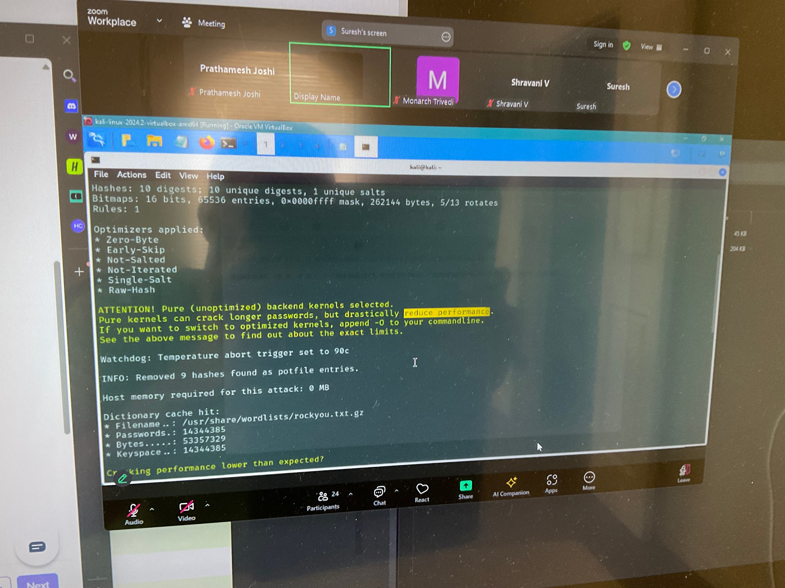
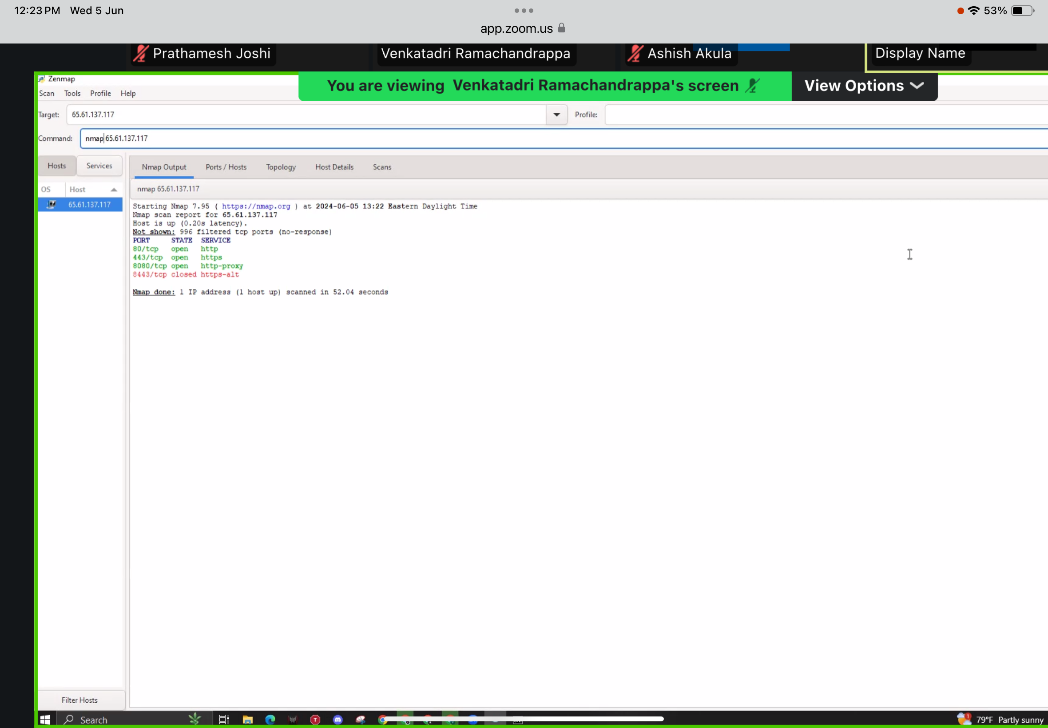
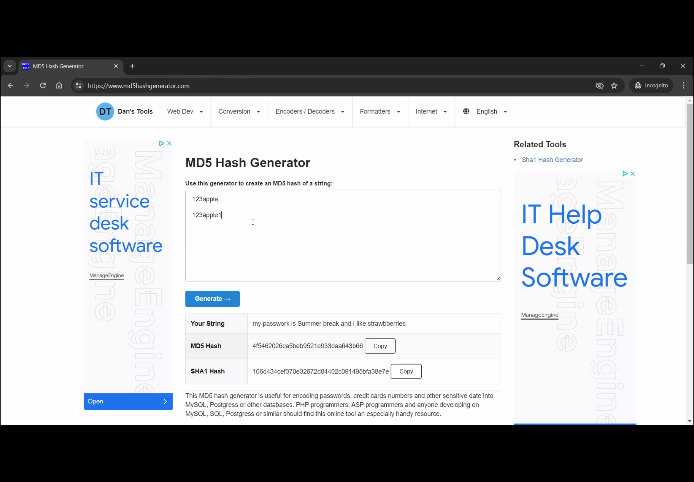
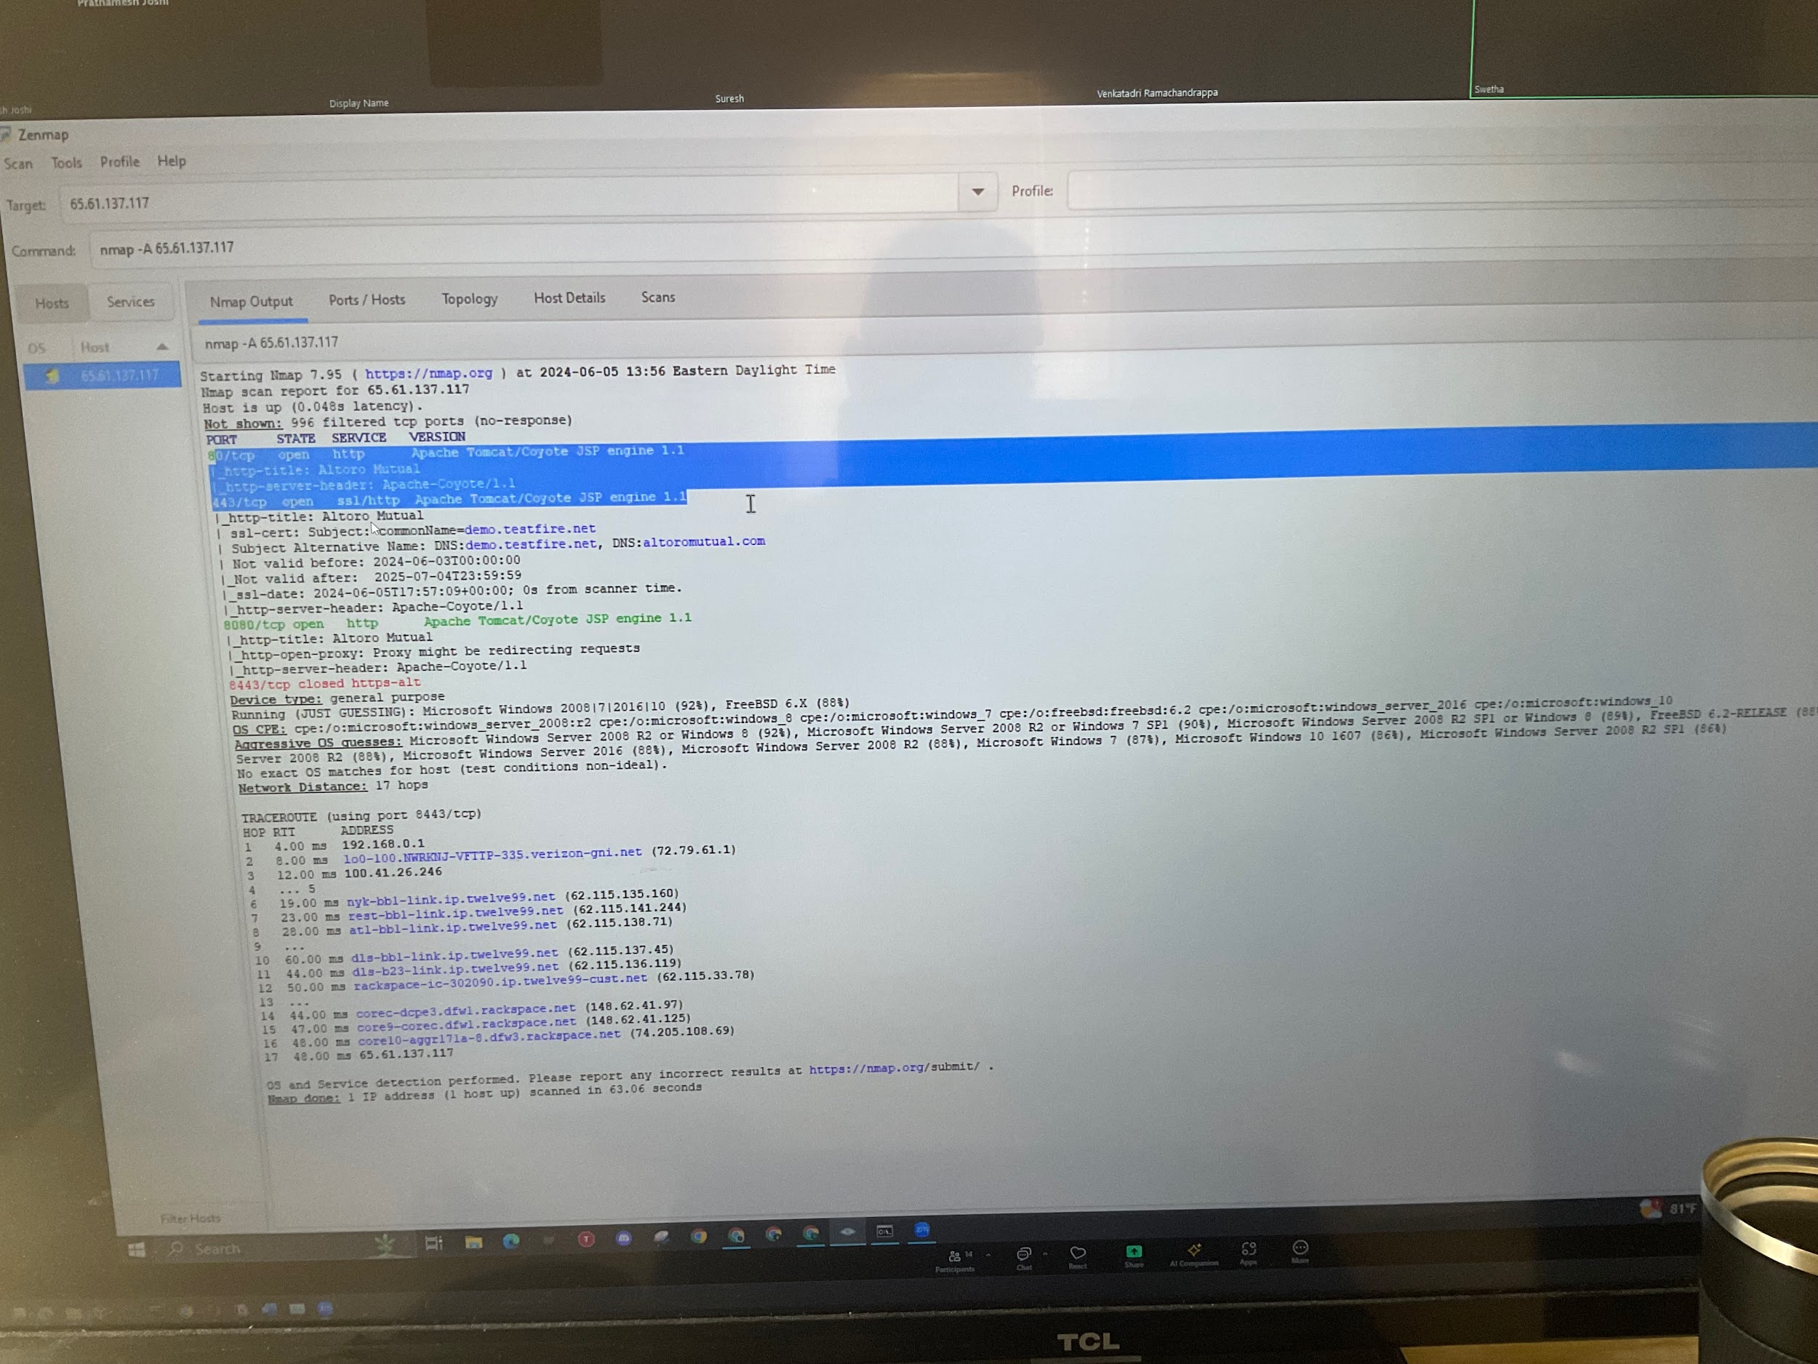
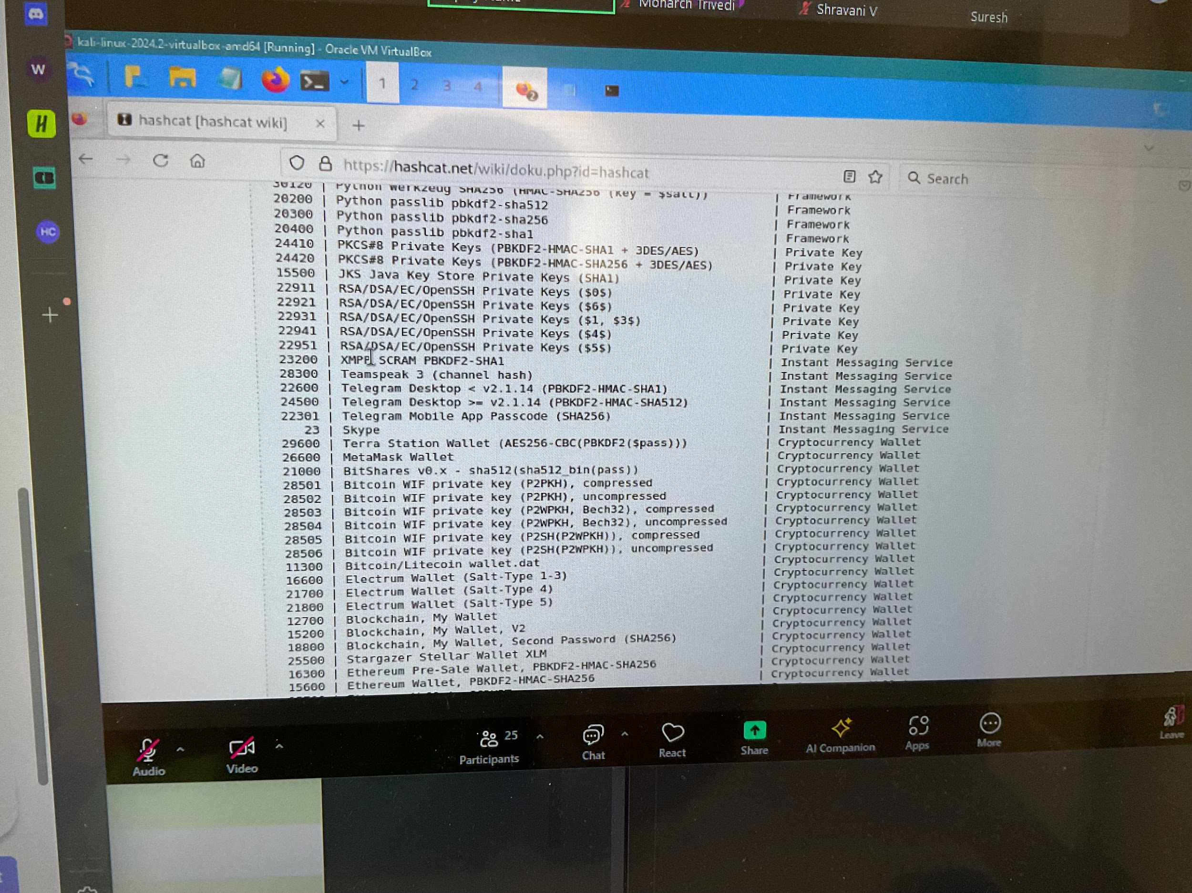

Slide 7
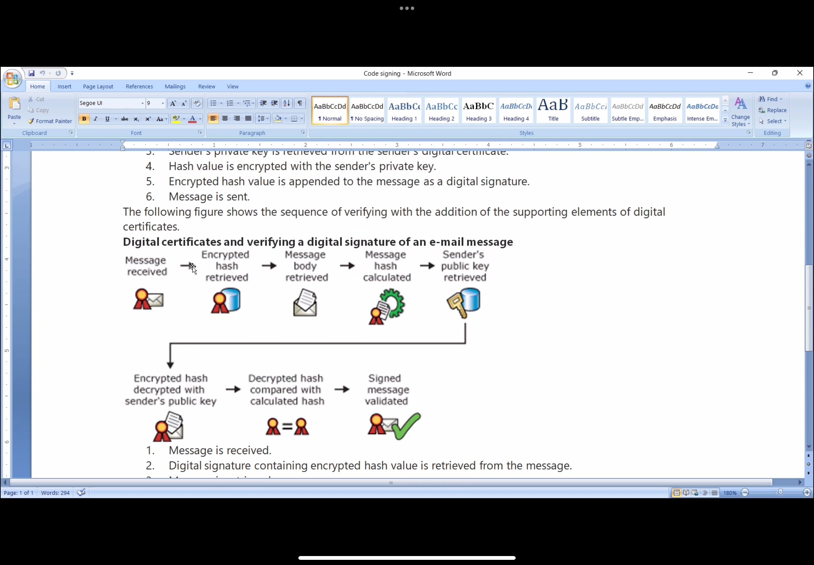
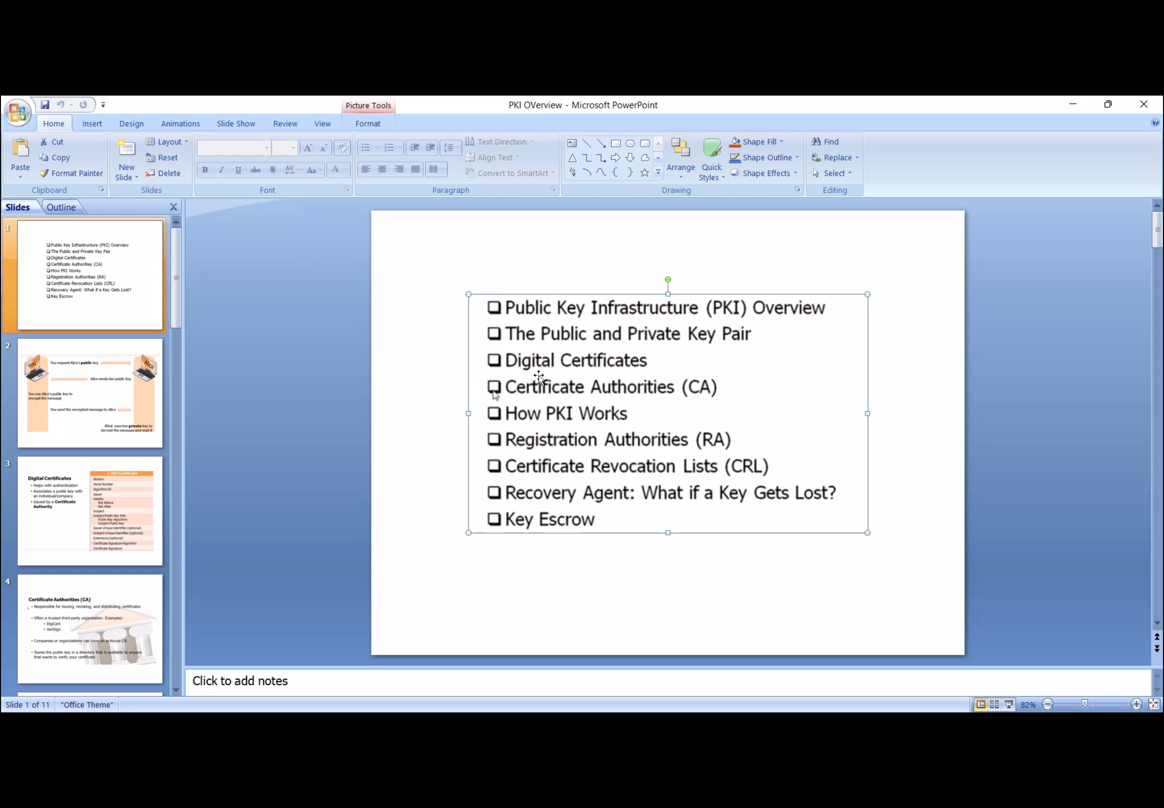
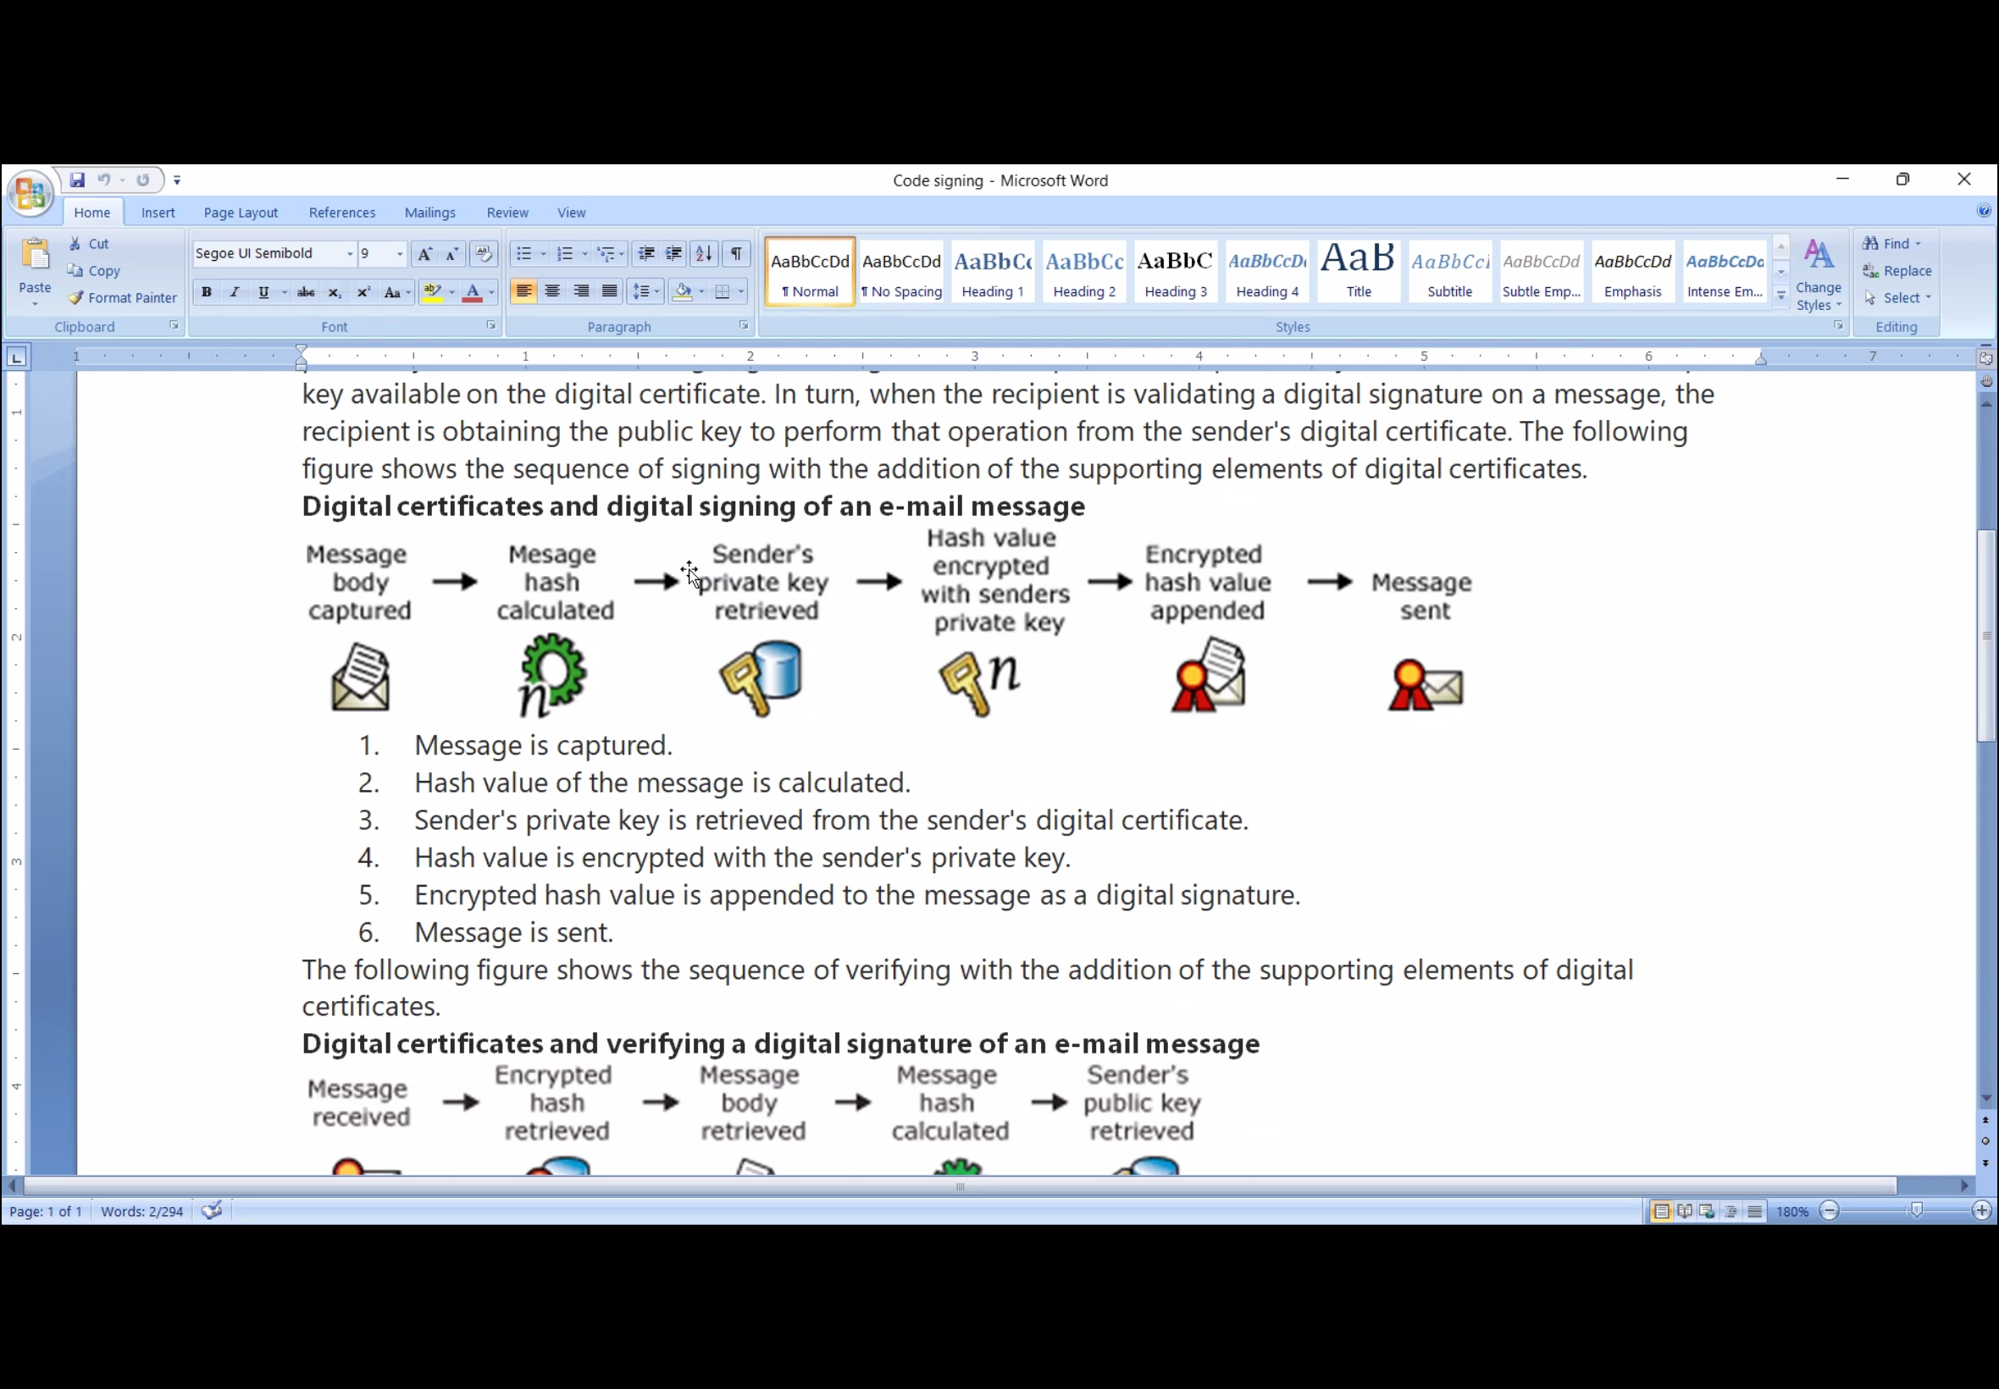
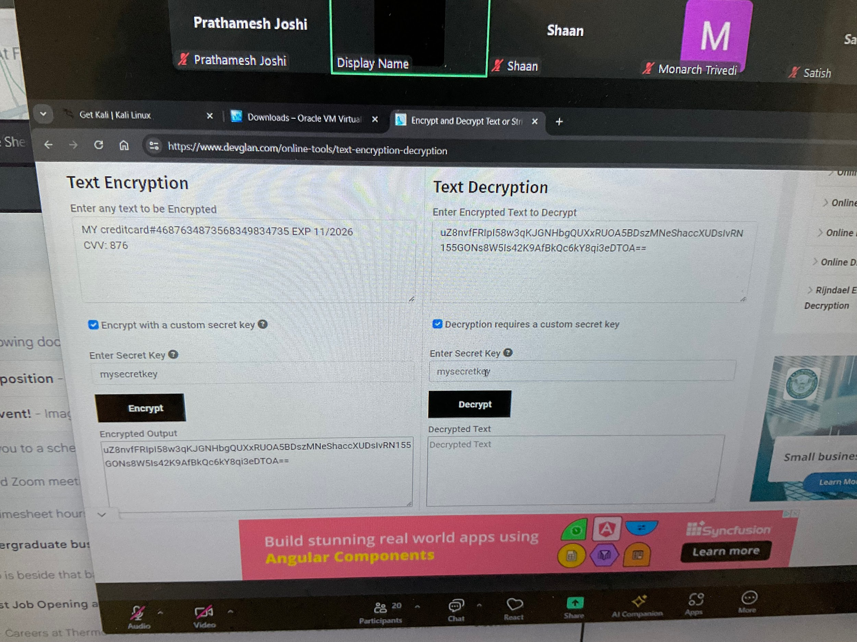
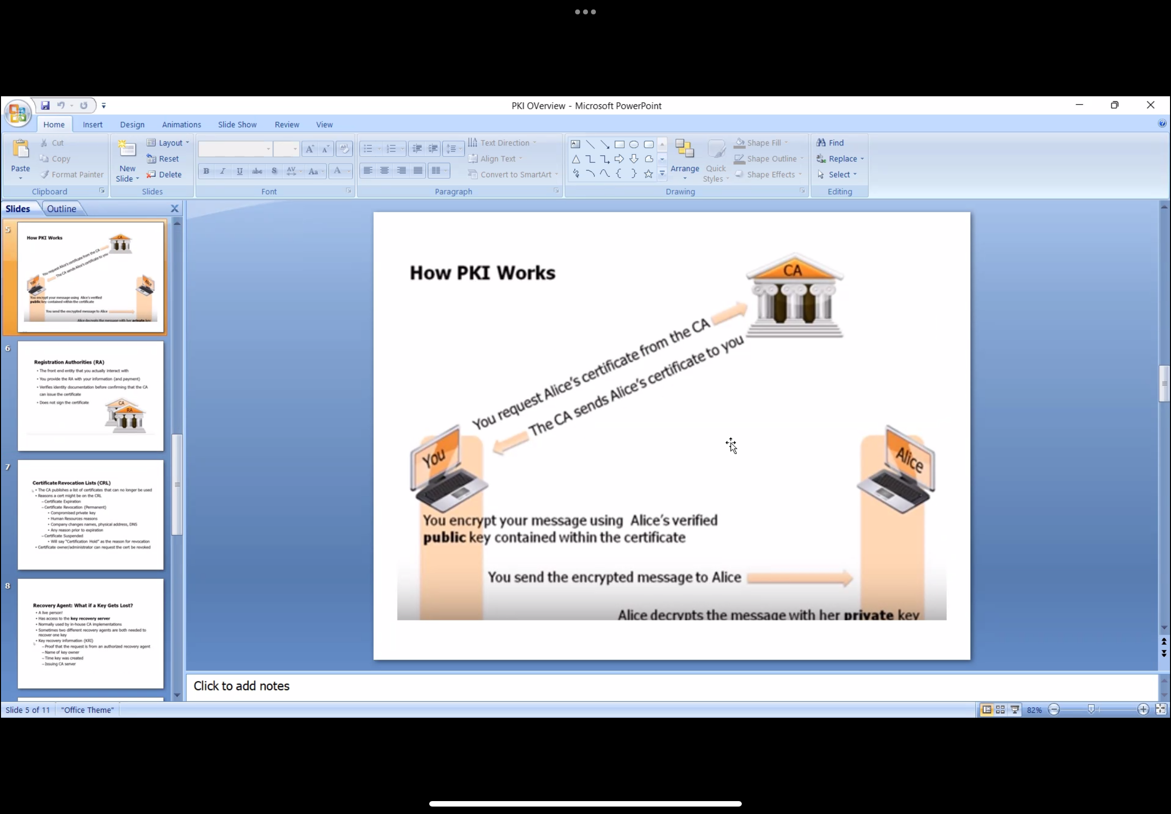

Slide 8
 | Method | Advantage | Technique | Disadvantage | Solution
1 | KNN |  | Distances | Normalization Large Dimensions
2 | Decision Trees | mixed Variables, interpretable, Missing data, no standardization | Gini index, Misclassification err, Entropy | Instability Additive structures | RF / Boosting SVM
3 | Pruning |  | Cross validate on c_{p} = (1/Tree_size)
4 | Bagging | Improved variance, Bias no change | Bootstrap samples, Out Of Bag err | non interpretable, correlated variables | Variable importance
5 | Random Forest | Improved variance than CART Reduced correlation / overfitting than bagging | No of variables > tuning param
6 | Boosting | Reduced Bias Easy computing | Weighting based on classification Minimize Exponential loss
7 | SVM |  | Quadratic programming Lagrange multipliers | Overlapping classes Normalization | Tuning param SVM
8 | Tuning param | Fit more data | Decrease margin | Linear fitting | Kernel SVM
9 | Kernel SVM | Non-linear fitting | Hinge loss, Binomial Deviance
10
11 | Neural Nets | Flexible, Logistic / Linear regression | Back propagation | Multiple minima Overfitting Normalization | Weight decay Early stopping Scaling inputs
12 | Convolutions | Fewer weights = filter_size X filters
13 | Pooling | shrink the layers leading to fewer weights, no weighing

Slide 9
Method | Advantage | Technique | Disadvantage | Solution
PCA | Linear combination of variables | Orthogonal eigen vectors | Linear, Outliers
Covar PCA |  | Standardize all vars
Corr PCA
Kernel PCA | Non-linear
MDS | Rows(nxn) v/s Variables(pxp) p>>n Biological system | Dissimilarity matrix
Isomap |  | Build adjacency graph, K-nearest neighbors. Epsilon-radius ball | expensive to compute
K means clustering |  | Silhouette effect | Depends on each instance, choice of k Different size, density must be circular shape | Use Model based clustering
Model based GMM mix | Different size | Expectation maximization | Density, outliers must be ellipsoidal shape
Hierarchical | Non-circular shape | Dissimilarity matrix
Single linkage | Can handle diverse shapes/sizes | MIN | Sensitive to noise
Complete link | Robust to noise | MAX | breaking large clusters; preference for spherical clusters
Group avg | Less susceptible to noise | AVG | preference for spherical clusters
DBSCAN | Non-circular shape Eliminate noise |  | Density High dimensional data
Spectral | Non-circular shape

Slide 10
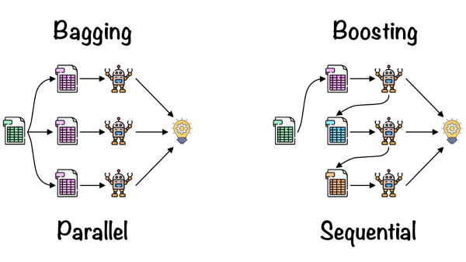
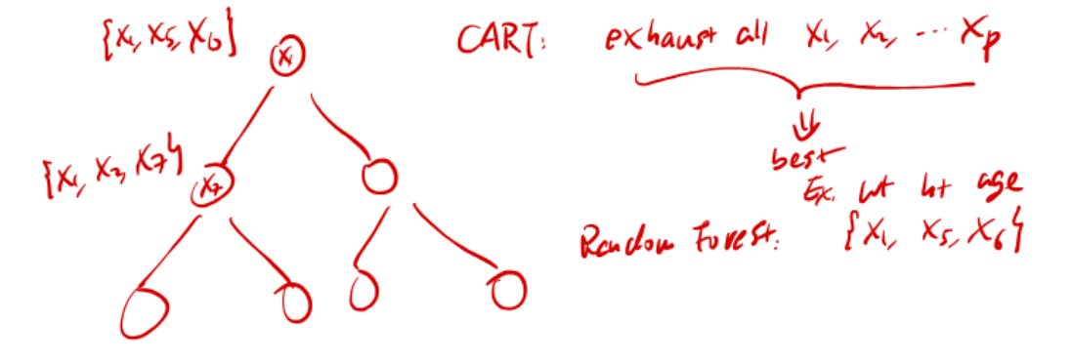
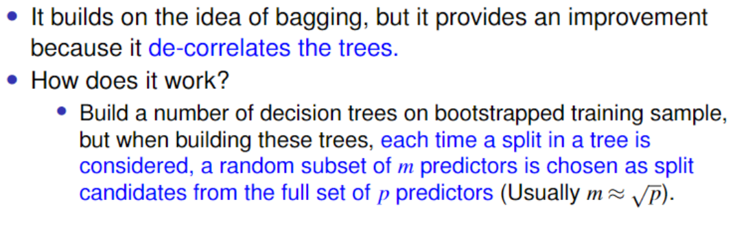
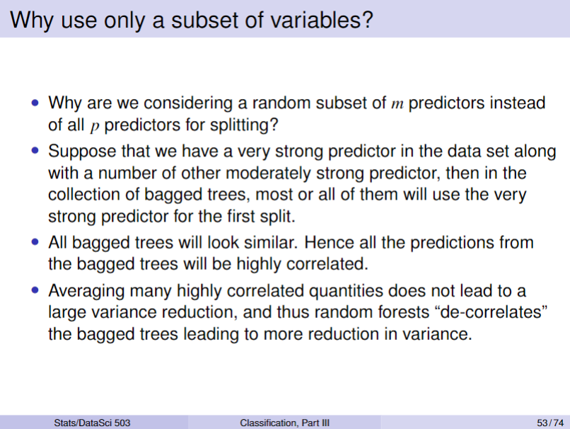
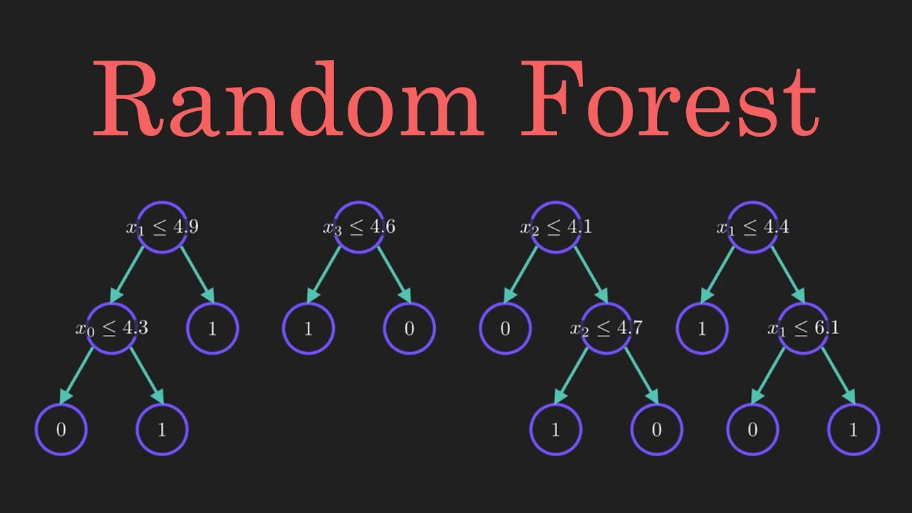

Slide 11
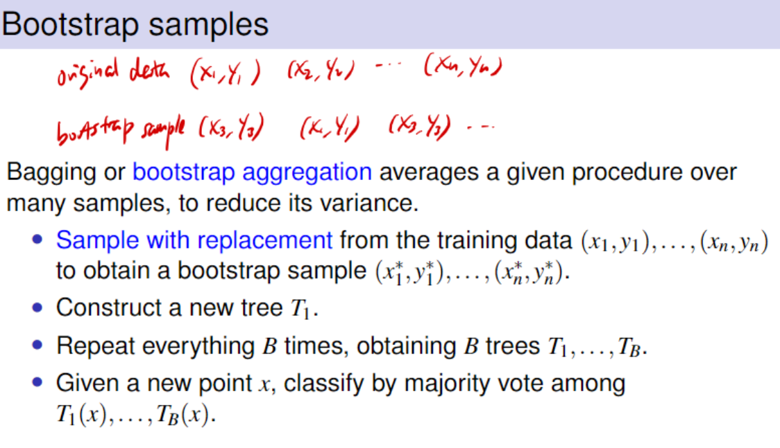
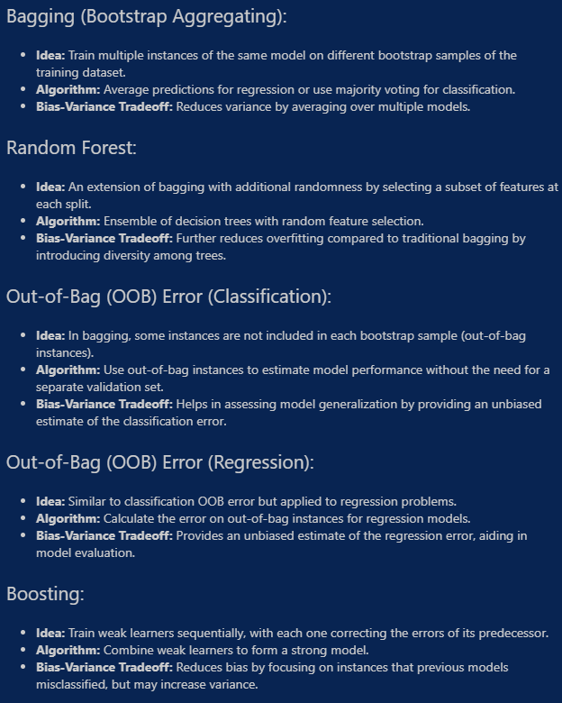
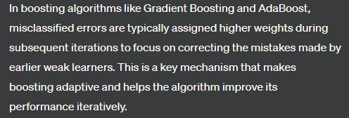
For each point, there are some trees which do not have that point in their bootstrap sample. Aggregate the result of these trees for this point and compare the prediction with the true value. This is OOB error.

Slide 12
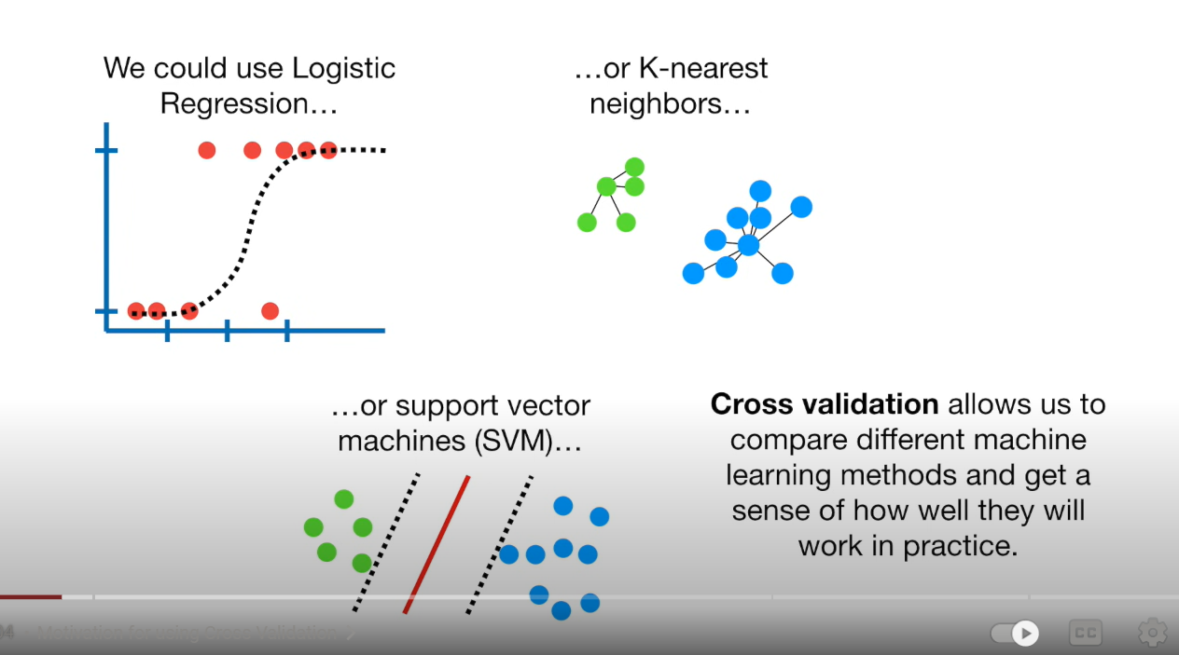
How is it possible for one problem to be solved by various techniques?

Slide 13
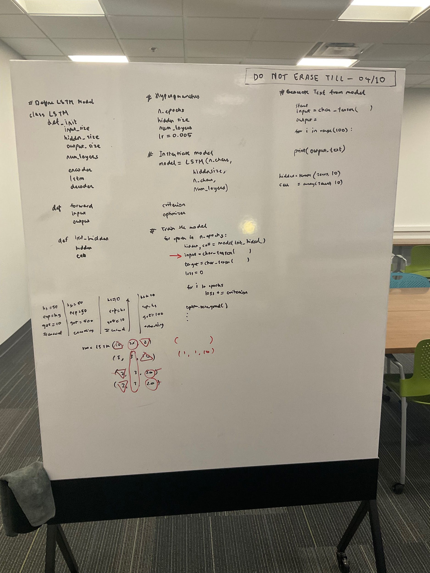
Distance from the Coast
Median House Value
Median Income

Slide 15
- Check for null values
- 77 models
- fit on all train and test data
- SVR model
- Remove year column
- Remove 2014 data
- 1 model
- use avg traffic
- SVR model
- One hot encode communities

Slide 16
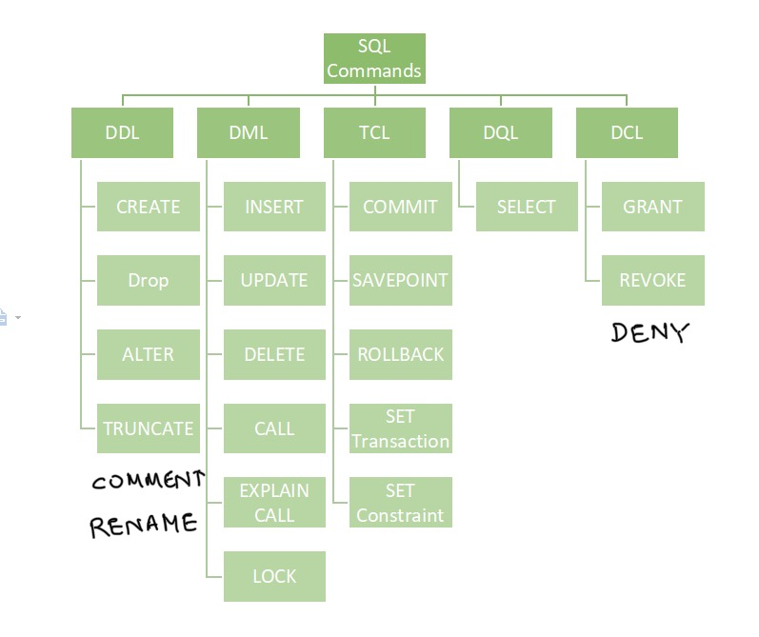

Slide 17
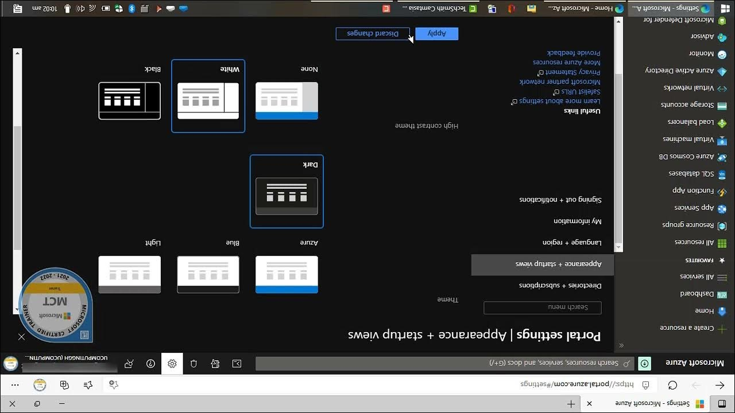

Slide 18
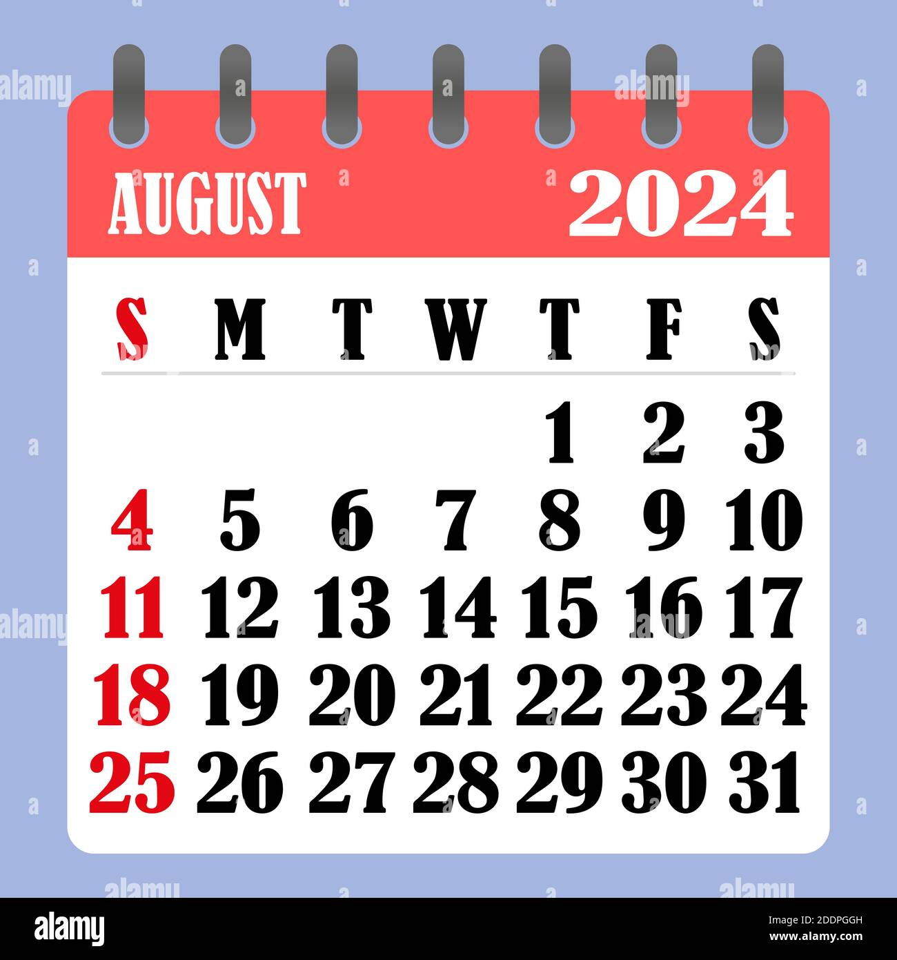
DAYS
LEFT
74

Slide 19
Primary Questions
General Questions:
Tell me about yourself / work experience
I am Prathamesh Joshi, a data Scientist with more than 5 years of experience in Data Science Industry. I have recently completed my Masters in Data Science from University of Michigan Ann Arbor. Previously I have an extensive work experience of working at Axtria, which is an IT company with an office in India. I have 2 internship experiences in Data Analytics field. Post my graduation, I have started my journey of self Learning and improving my skills
I am eager to learn new technologies and hence I have completed Azure fundamental certifications and also linkedin learning on Healthcare industry. I am expecting to complete a Microsoft Power BI certification in 1 week from now.
How do you stay updated with the latest trends and technologies in data analysis?
Certifications, Linked Learning, Youtube
Which data analysis tools and software are you proficient in?
Python - multiple projects, seaborn, matplot for plotting
Power BI / Jasper - data visualization tools
Salesforce - CRM tool
Azure - cloud technologies, engaged with recent technologies
Personal Round
Describe a performance that you are proud of
On one occasion, I was on paid leave and had to travel out of town. During this time, my manager informed me about an urgent need for a discussion with the Business team in the US. Despite not having my personal system with me, I joined the call using my phone.
The discussion revolved around a significant change impacting six teams we worked with, specifically regarding their dashboard look, permission, and access settings.
Given the urgency, we needed to assess the feasibility of the requirements immediately. Leveraging my proficiency with the system and my understanding of the project, I was able to provide solutions for about 80% of the major points on the spot. The minor details were subsequently addressed and shared in due course. This experience underscored my ability to remain adaptable and responsive, even in challenging circumstances.
Available to work on weekends
I understand the importance of flexibility in today’s work environment. While I am certainly open to occasional weekend work if it is necessary to meet the deadlines or support team projects, I also value maintaining a healthy work life balance. It is crucial for me to recharge and spend my time with friends and family.
Describe a situation where you had to work closely with designers, management, and other stakeholders on a data project. How did you ensure everyone was aligned?
In my last role, we worked on launching a new product. I collaborated with designers to understand customer preferences, with management to align the project with business objectives, and with developers to ensure technical feasibility. Regular meetings and clear communication were key to our alignment
Introduction
What is the date you can start the job?
The start date on my Employment Authorization Document (EAD) is August 2nd and I can start my job immediately
What is your expected Salary
70k $ to 90k$ annually
33$ / hr - 43 $ / hr
Where do you see yourself in next 5 years?
Career paths, mentoring, training courses
build your own career path
project management, leadership
Time management when you had tight deadline. "In a previous role, we had a critical project with a tight deadline. To manage tasks effectively, I adopted: Prioritized tasks Make detailed timeline Frequent check-ins Project management tools Bottle neck issues – delegated the tasks to experts Pomodoro – time management Clear communication Progress and challenges Meticulous planning and agile adaptations | Training to Juniors Structured onboarding Hands on training Review sessions Documents and Resources Independent activities

Slide 20
Data Analyst Experience
Technical Round - Analytical Skills:
How do you ensure the accuracy and integrity of data in your reports?
How do you approach problem-solving when you encounter a data issue?
Check data flow at each step
Data Inconsistencies
In a Beyond Scoreboard project involving the integration of multiple databases,
variations in data formats and recording practices.
comprehensive data mapping and cleansing strategy.
establish standardized data formats,
the combined file matched with online records
maintaining data consistency throughout the project.
Did you create data dictionaries for a database
Technical Round - Data Visualization
How did you use reporting softwares
Power BI - role based access
Salesforce Reporting - system logs
Jasper Reporting - parameter based reporting
What experience do you have with data visualization tools? Can you provide examples of the types of visualizations you have created?
Provide goals, sales, % target achieved
Hierarchical summary, Users, Managers
Overview summary page year, monthly details page
Explain your experience in Power BI / Tableau
Used for customer behaviour analysis for banking / credit risk analysis
imported data, role based dashboards
Can you walk us through your process for creating a detailed report from raw data?
Data Import,
Data modelling - creating semantic relations / measures - DAX,
Show / hide fields, creating measures
Selecting visuals, Role based permissions
Why data reporting
Fascinated by the way in which data can be represented
Creating presentations have always intrigued me to represent my work achievements - technical stats to non technical audience
it comprises of data engineering, warehousing, outcome prediction
also get to be a part of Business Intelligence team and learn more about Healthcare
Communication and Presentation:
How do you communicate your findings to non-technical stakeholders?
Can you give an example of a time when your analysis influenced a business decision?
Scenario-Based Questions:
Imagine you have conflicting data from two different sources. How would you resolve this issue?
If a report you generated contained an error, how would you handle the situation?
Behavioral Questions:
Describe a time when you had to work under tight deadlines. How did you manage your time and ensure the quality of your work?
How do you handle feedback or criticism regarding your reports?
Future-Oriented Questions:
What do you see as the biggest challenge in the field of data analysis today?
Where do you see yourself in five years, and how does this role align with your career goals?
Large Datasets
Data Extraction and Cleaning - python, pandas, 2 million
Data normalization - MinMaxScaler()
select specific set or recommendations based on assumptions - 50 k
Genre hierarchical clustering - based on jacob similarity
Principal component analysis, SVD, Mutual Information
I used Python's pandas library with chunking and applied vectorized operations to optimize performance. This approach reduced the processing time by 40%
Definition: Chunking involves breaking a large dataset into smaller, manageable chunks or pieces.
Usage: When dealing with massive datasets that may not fit into memory entirely, chunking allows you to process a portion (or chunk) of the data at a time.
NLP: use batch size for training model

Slide 21
Python
How do you ensure the accuracy and reliability of your Python scripts?
For Python scripts, focus on unit testing by verifying the correctness of individual functions. Leverage version control systems like Git for tracking changes, facilitating identification and resolution of issues. Conduct code reviews to obtain feedback on logic and potential enhancements. Implement robust error handling, comprehensive documentation, and test scripts with diverse data scenarios, including edge cases. Manage dependencies using virtual environments or package managers to ensure a consistent and reliable environment. These practices collectively contribute to the accuracy, reliability, and maintainability of Python scripts throughout development.
What applications of data analysis you have used
Give information about data discrepancies occurred and how you dealt with it In a Beyond Scoreboard project involving the integration of multiple databases, data discrepancies arose due to variations in data formats and recording practices. To address this challenge, I developed a comprehensive data mapping and cleansing strategy. I collaborated with teammates to establish standardized data formats, implemented data validation checks, and conducted thorough reconciliation processes. This proactive approach not only resolved existing discrepancies but also laid the foundation for maintaining data consistency throughout the project.
Describe a time when you analyzed a large dataset. What was the challenge, and how did you overcome it?
In my previous project on Flight data analysis, I analyzed a dataset with over 50 million records to identify flight trends. The challenge was the dataset size, which required efficient processing. I used Python's pandas library with chunking and applied vectorized operations to optimize performance. This approach reduced the processing time by 40%
Definition: Chunking involves breaking a large dataset into smaller, manageable chunks or pieces.
Usage: When dealing with massive datasets that may not fit into memory entirely, chunking allows you to process a portion (or chunk) of the data at a time.
NLP: use batch size for training model
What is your proficiency level with Power BI, Tableau, and Excel? Can you share an instance where you used these tools to provide actionable insights
Power BI was strategically employed post-integration with SQL Server to generate visualizations for customer engagement. Different summary charts were made for different hierarchy of users from End Users, Managers to Executives allowing for dynamic and real-time visualizations.
EXCEL: data cleaning
SUMIF, CountIF, Concatrnate: for conditional calculations and text manipulation.
Vlookups, Hlookups for Lookup functions for retrieving data from different ranges.
PivotTables: Essential for dynamic and interactive data summarization when computing login history tally over month.
Can you describe your experience with Python? Provide examples of projects where you utilized these languages
Python for data visualization, manipulation and analysis
Used pandas and numpy for data cleaning and data comprehending
scikit learn for PCA, applying machine learning models
Matplotlib and seaborn for data visualization
Extracted data from a webpage
discuss the structure of a complex query or a Python algorithm you’ve written
In developing a Python algorithm for sentiment analysis, the process involves loading a dataset, preprocessing the text data through techniques like TF-IDF vectorization, and splitting it into training and testing sets. The algorithm then employs a logistic regression model for sentiment classification. The model's accuracy is evaluated using metrics like accuracy score. This structured approach ensures effective analysis of sentiment in textual data, applicable in diverse natural language processing tasks.
10 Questions in Python
Scripting vs Module
Multi threading vs Multi processing

Slide 22
 |  | Data Pre-processing | Data Processing | Visualizations
R | Time Series | The data pre-processing involved handling missing values, applying transformations to stabilize the variance, and decomposing the time series into trend, seasonal, and irregular components. | `forecast` package develop a model for predicting future sales based on historical data
Python | Comparative Analysis
Python | Enoki Project | created a data pipeline that integrated data from Google Sheet APIs, script involved complex operations such as handling asynchronous API calls, processing JSON responses, | sand performing feature engineering on the data before feeding it into a machine learning model
R | Technocolabs Project | identify customer churn | data science pipeline by implementing Decision Trees, Random Forest and SVM training up to 92% through hyperparameter tuning | map visualizations leveraging libraries such as caret and ggplot2 in R
Python | Lyrics Generator | text preprocessing, tokenization import re, tokenizer, tensorflow, keras, pytorch, sparse, pickle | creative lyrics generator using LSTM and RNN multiclass classifier, transformers, | BLUE score of 60% for bigram metric, outperforming baseline models by 25%.
Python | Beyond Scoreboards | player clusters PCA, top 5 reducing data size by 400%. Data Inconsistencies | SHAP analysis Scikit-learn - Applied Machine Learning and Regression analysis R-squared value up to 92% | Data Visualization for raincloud plots, swarm plots, radar plots etc. Seaborn
Python | Anime Odyssey | Large Data Set Data Extraction and Cleaning - python, pandas, 2 million Data normalization - MinMaxScaler() specific set of recommendations based on assumptions - 50 k Genre hierarchical clustering - based on jacob similarity Principal component analysis, SVD, Mutual Information | building recommendation system | build word cloud using matplotlib.pyplot
Power BI / BO/ TABLEAU | Market Insights
SQL | IIT mandi internship | Recursive Common Table Expression (CTE) to calculate the hierarchy of employees. The query needed to dynamically traverse a self-referential table where each employee had a manager, and return a report showing each employee's level in the hierarchy and their respective reporting chain. The query also included several subqueries and window functions to calculate cumulative metrics for each level in the hierarchy. | Implemented security protocols for 10+ databases (SQL Server, Oracle DB, PostgreSQL), ensuring data integrity and managing access permissions for 50 + users. data modeling, data cleaning, query optimization, programming, and indexing, resulting in a 12% reduction in processing time through proactive project management, streamlining operations and improving business intelligence efficiency.
Spark | Youtube Olympics Project | complex data processing | reading a large dataset from HDFS, applying multiple transformations, and then writing the results back to a distributed storage system | filtering, joining with other large datasets, and aggregating data based on several keys. | optimized using Spark's DataFrame API | implementing partitioning and caching strategies to reduce shuffle operations | ETL pipeline that processed terabytes of raw log data from multiple sources, transforming it into a structured format for analysis | data cleansing, aggregating user sessions, and joining with reference tables | Databricks' Delta Lake for handling incremental updates efficiently and used Spark SQL for complex joins and aggregations, ensuring that the pipeline was both scalable and performant.
 | Axtria | EXCEL: data cleaning SUMIF, CountIF, Concatenate: conditional calculations and text manipulation. Vlookups, Hlookups for Lookup functions for data from different ranges. PivotTables: Essential for dynamic and interactive data summarization when computing login history tally over month. | Pharmacy Data | Salesforce Analysis

Slide 23
Questions
Experience with Healthcare Plan Data Analysis
focusing on medical claims, data mining, and financial processing
large datasets to find pattern in medical claims
high-cost claimants or frequent service utilizations
data mining to uncover hidden trends and inefficiencies in the healthcare plan operations
member eligibility processing
provider networks were in compliance with MCO
federal and state regulations
Experience in T-MSIS
end-to-end process of collecting, analyzing, and reporting on T-MSIS data
integrating data from multiple sources, including claims systems, eligibility files, and provider enrollment records
accurate and compliant with CMS (Centers for Medicare & Medicaid Services
monitoring data quality
used SQL
compliance with T-MSIS reporting requirements
Staying Up to Date on Changes to T-MSIS Business Specifications
regularly reviewing updates from CMS and participating in relevant webinars, training sessions, and industry forums
maintain close communication with our compliance and IT
changes in business specifications are promptly incorporated into our data processing and reporting workflows.
proactive approach
T-MSIS data submissions are always compliant with the latest federal and state regulations
minimizing the risk of penalties or data rejections
Knowledge of Drug Data File Elements (ICD, Medi-Span, First Data Bank)
drug compendia like ICD,Medi-span, First Data Bank
integrating data sources to pharmacy mgt sys
drug information: NDC codes, therapeutic classes, pricing details
Medi-span: drug pricing and therapeutic equivalence data
FDB for clinical information: drug interactions
ICD coding mapping diagnoses to therapies
compliance with regulatory requirements
optimizing patient care
Familiarity with Pharmacy and Non-Pharmacy Medicaid Claims Processing
financial and institutional data elements
analyzing claims data to identify trends, discrepancies, and opportunities for cost savings
claims were processed accurately, adhering to both state and federal guidelines
claims from hospitals and other healthcare providers were compliant with Medicaid rules
eligibility data: only eligible members received coverage
provider networks met the requirements outlined
Proficiency in SQL and Data Analysis
regularly to query databases, extract relevant data, and perform in-depth business analysis
complex SQL queries to join multiple tables, subqueries, aggregate data, and filter results based on specific criteria.
data models, data element dictionaries, and schema
understand the underlying structure of the databases
efficient and accurate queries
detailed reports on claims data, provider performance, and financial metrics.
My ability to work with data dictionaries and schema also ensures that I can communicate effectively with both technical and non-technical stakeholders, bridging the gap between data and actionable business insights.
Python and R, which I use for more advanced data processing and statistical analysis
Creating Data Presentations Using Tableau / Business Objects
create impactful data presentations and reports
transform complex healthcare data into intuitive visualizations
created dashboards that highlight 'hot spots' in healthcare costs,
quickly identify areas that require attention
depict trends over time, demographic breakdowns, and provider network performance
key stakeholder questions that answers

Slide 24
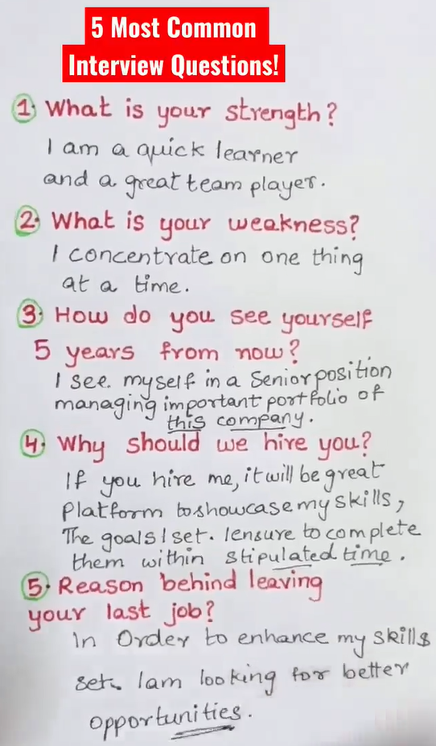
Company Review
Your role in our mission
Collaborate with team members and stakeholders to define key business metrics and gather requirements for which insights should be made available at scale. Architect data pipelines, design and build new dashboards for stakeholders to use to address their needs. Maintain and improve existing data infrastructure and dashboards based on evolving business requirements.
Publish and maintain clear documentation to inform and educate users at scale, gather feedback to identify opportunities for improvement.
Identify ways to streamline and improve the efficiency of our data. Implement changes to our infrastructure (optimize SQL queries and data workflows) to improve the landing time of our data.
Work with cross-functional teams including to identify data needs and gaps and align on solutions.
Lead projects end to end, see around corners, and provide thought partnership to your team.
Demonstrated ability to learn and apply newly emerging data analytic toolkits depending on the problem statement.
Possess analytical strength and curiosity to understand and explain questions and observations in data.
What we're looking for
Four (4) or more years of Data Analytics experience.
Experience in Python and/or other data scripting languages.
Experience utilizing a business intelligence visualization tool (Cognos, Tableau, Power BI, etc.).
Experience in querying and analyzing and working with data languages and platforms to investigate large and diverse data sets.
Strong written and oral communication, and interpersonal skill to work effectively with team members, customer, and client.
Tell me about Gainwell
Providing technical solutions to healthcare sector
Medicaid management information system
government agencies > health data management
51 US states
New company in 2020 but 30 yrs of experience
Culture at Gainwell
Open communication, team work, work life balance
Financial benefits, leaves, remote work, life insurance
career mobility, explore, plan, build, execute
Healthcare industry
Every business has its different rules, Experience in Pharma data, credit risk data, airline data, textual data.
Optimizing the resources using data analytics for visualization and performance tracking, communicating with stakeholder, compliance, security are some of the transferable skills from pharma to healthcare
Top 10 skills for Healthcare Data Analyst
The Data Science of Healthcare, Medicine, and Public Health
Optimizing the resources
visualization and performance tracking,
communicating with stakeholder,
compliance, security
6 years work experience
3 yrs Axtria
6 mo internship
6 mo internship
1 year undergrad internship
1 year graduate internship

Slide 25
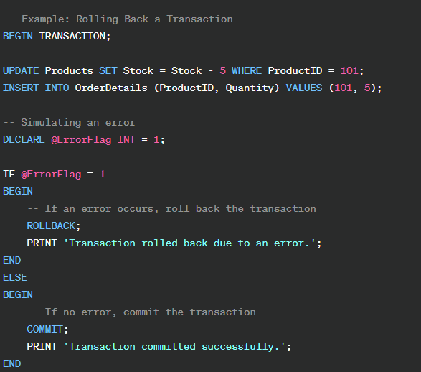
SQL
Problems in DBMS –
There was occurrence of duplication of data in tables
Testing in stages, parametric testing, optimizing queries, check data integration
For data modeling, I follow a structured approach starting with
requirements gathering,
conceptual design using ER diagrams,
logical design to define the schema, and
finally the physical design.
For instance, in designing a customer database, I normalized the data to the third normal form to
reduce redundancy, which also improved query performance
Concurrency Control in DBMS:
Concurrency control in a Database Management System (DBMS) refers to the mechanisms and techniques implemented to manage and coordinate access to the database by multiple transactions concurrently. The goal is to ensure that transactions can execute simultaneously without causing data inconsistencies or conflicts. Concurrency control plays a crucial role in maintaining the consistency and integrity of the database in a multi-user environment.
Types of Concurrency Control:
Lock-Based Concurrency Control:
Description: Transactions acquire locks on database objects (e.g., tables, rows) to control access.
Shared Locks: Allows multiple transactions to read but not write.
Exclusive Locks: Prevents other transactions from accessing the locked resource.
Concurrency Control Mechanism:
Timestamp Ordering: Transactions are ordered based on their timestamps, and conflicts are resolved using predefined rules.
Assists in the analysis and validation of basic database structures, models and processes to ensure definition according to business objectives and operations.
1. **Understand Business Objectives:**
- Begin by understanding the business objectives that the database is supposed to support. Work closely with stakeholders to gather requirements and define the scope of the database.
2. **Data Modeling:**
- Utilize data modeling techniques to create a conceptual, logical, and physical model of the database. Ensure that the model accurately represents the relationships and constraints between different entities.
3. **Validation of Database Structures:**
- Conduct thorough validation of the database structures against the established data model. Check for normalization, proper indexing, and adherence to best practices for data storage.
4. **Data Integrity Checks:**
- Implement data integrity checks to ensure the accuracy and consistency of data. This involves setting up constraints, such as primary keys, foreign keys, and unique constraints, to maintain data quality.
5. **Performance Optimization:**
- Analyze and optimize database structures for performance. Consider indexing strategies, query optimization, and proper use of data types to enhance the overall efficiency of database operations.
6. **Security Assessment:**
- Assess the security measures implemented within the database. Ensure that access controls, authentication, and authorization mechanisms are in place to protect sensitive data.
7. **Data Validation and Cleansing:**
- Implement validation rules and data cleansing processes to identify and correct inaccuracies or inconsistencies in the data. This contributes to maintaining a reliable and trustworthy database.
8. **Documentation:**
- Document the database structures, models, and processes comprehensively. This documentation should serve as a reference for future maintenance, troubleshooting, and knowledge transfer.
9. **Collaboration with Developers:**
- Collaborate with developers to integrate the database structures into applications. Ensure that the database design aligns with the needs of the applications using it.
10. **Testing:**
- Perform thorough testing of the database structures and processes. This includes unit testing, integration testing, and validation against real-world scenarios to identify and address any potential issues.
11. **Continuous Monitoring and Improvement:**
- Set up monitoring mechanisms to track database performance and identify areas for improvement. Regularly review and update database structures to accommodate evolving business requirements.
12. **User Training and Support:**
- Provide training and support to end-users regarding the proper use of the database. Address any queries or issues they may have and ensure that users are comfortable interacting with the database.
Normalization
Database normalization is the process of organizing data in a relational database to reduce redundancy and improve data integrity. The normalization process involves dividing large tables into smaller, more manageable tables and defining relationships between them. There are several normal forms, each addressing different aspects of data organization. Here are some common types of database normalization techniques:
First Normal Form (1NF):
Objective: Eliminate duplicate data and ensure each column holds atomic values.
Requirements: Each table cell must contain a single, indivisible value. All entries in a column must be of the same data type.
Second Normal Form (2NF):
Objective: Eliminate partial dependencies on composite primary keys. “A_B” key
Requirements: Must be in 1NF, and no non-prime attribute (attribute not part of the primary key) should be functionally dependent on only a part of the primary key.
Third Normal Form (3NF):
Objective: Eliminate transitive dependencies.
Requirements: Must be in 2NF, and no non-prime attribute should be transitively dependent on the primary key. In other words, no non-prime attribute should depend on another non-prime attribute.
Indexing – Clustered, non-clustered
Atomicity: all parts of a transaction are completed successfully. the entire transaction is rolled back
Consistency: from one valid state to another,
Isolation: Ensures that transactions are executed independently of one another.
Durability: Ensures that once a transaction is committed, the changes are permanent, even in the case of a system failure. The data is reliably stored and can be recovered.
Data Base structure
- **Tables:** Fundamental units, rows, and columns.
- **Columns:** Attribute representation with specific data types.
- **Rows:** Contain actual data entries for unique instances.
- **Primary Key:** Unique identifier ensuring data integrity.
- **Foreign Key:** Links columns between tables, establishes relationships.
- **Indexes:** Data structures for efficient data retrieval.
- **Relationships:** Define how tables are related (one-to-one, one-to-many).
- **Data Types:** Specify the kind of data in columns for accuracy.
- **Constraints:** Rules and conditions for data (primary key, unique, check).
- **Views:** Virtual tables generated by queries for simplicity.
- **Stored Procedures and Functions:** Precompiled sets of SQL statements for logic and rules.

Slide 26
SQL
How do you ensure the accuracy and reliability of your SQL queries?
For SQL Queries:
Testing in Stages: Break down complex queries test each part separately before combining them.
Use Sample Data: Test queries initially on a subset of the Check Execution Plans: Examine the execution plans to understand how the database engine is processing the query. Optimize queries for better performance.
*Avoid SELECT :
Use Parameters: Use parameterized queries to prevent SQL injection and improve query plan caching.
Data Integrity Checks: Implement checks for data integrity, ensuring that the results match expectations based on business rules.
Consistent Formatting: Follow a consistent formatting style to improve code readability and maintenance.
TTechnical Round - DBMS
Performance Issues
optimize SQL queries and data workflows
Data import, granularity, direct Query, query reduction
model relationships: Use single-directional relationships wherever possible
DAX formulas, nested functions
What problems did you encounter and how did you overcome them
SQL queries, semantic model issues
Can you describe a project where you used SQL for data analysis? What types of queries did you write?
SQL is always in combination with visualization tools.
Nested SQL statements: 2 joins, 5 parameters for Y Q M Role etc
Normalization, query reduction, indexing, primary / foreign key
Did you perform regular recovery and backups
Can you describe your experience with SQL?
SQL for data retrieval and management
Projects -
Imported data from SQL server using SQL queries

Slide 27
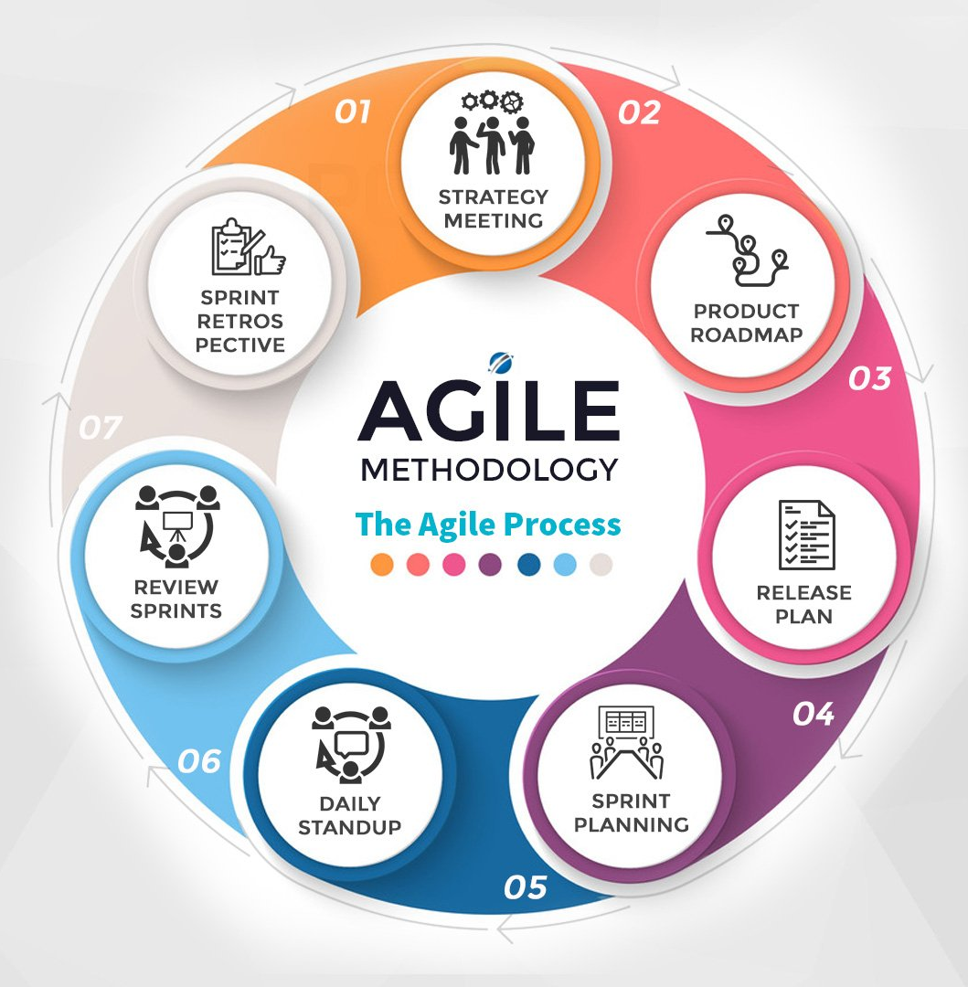
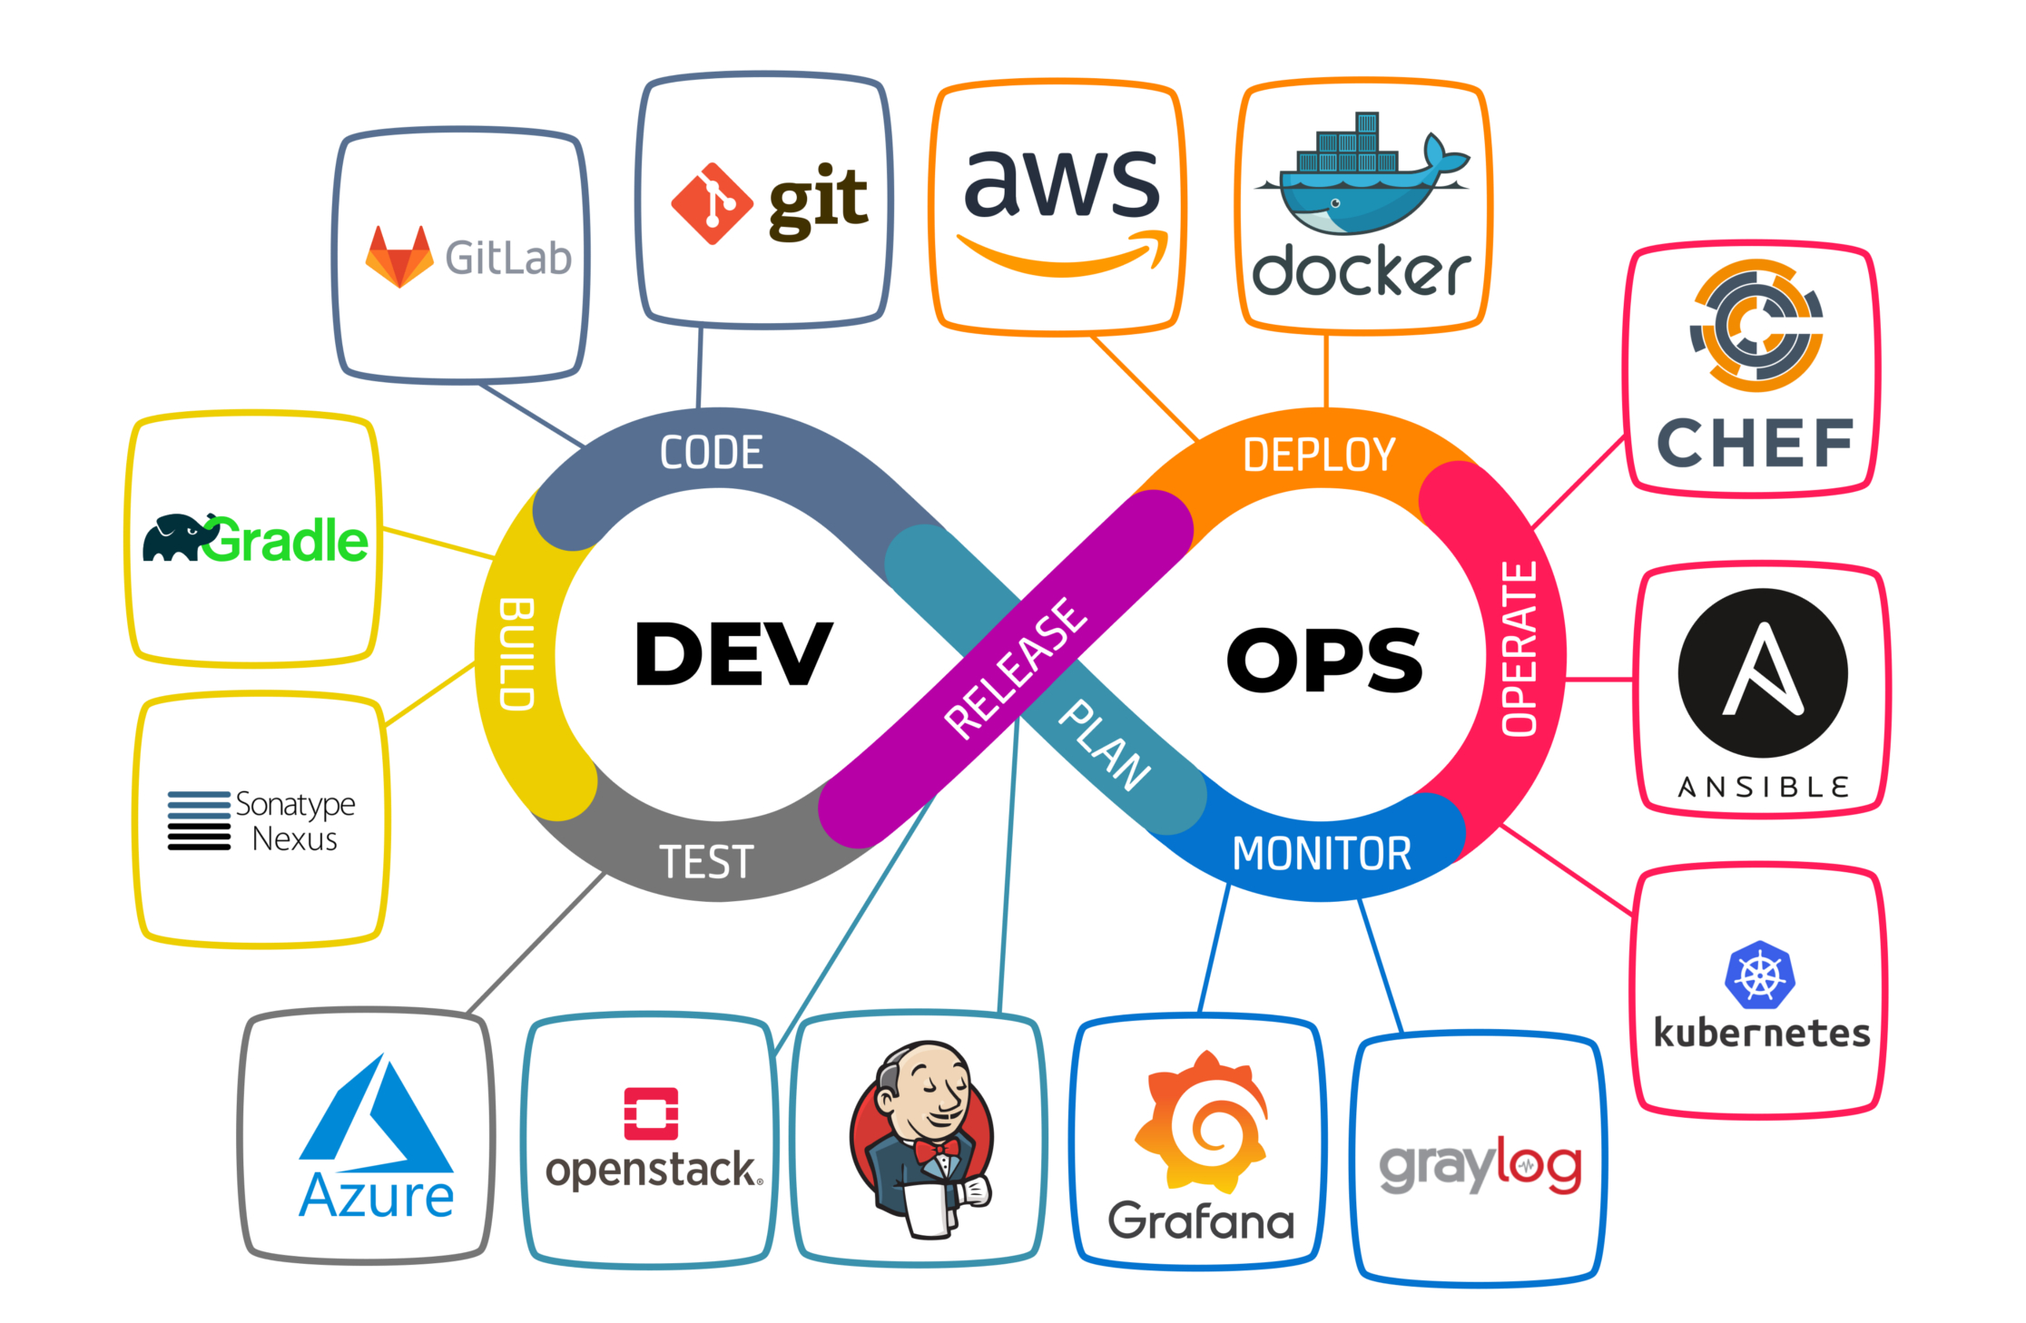
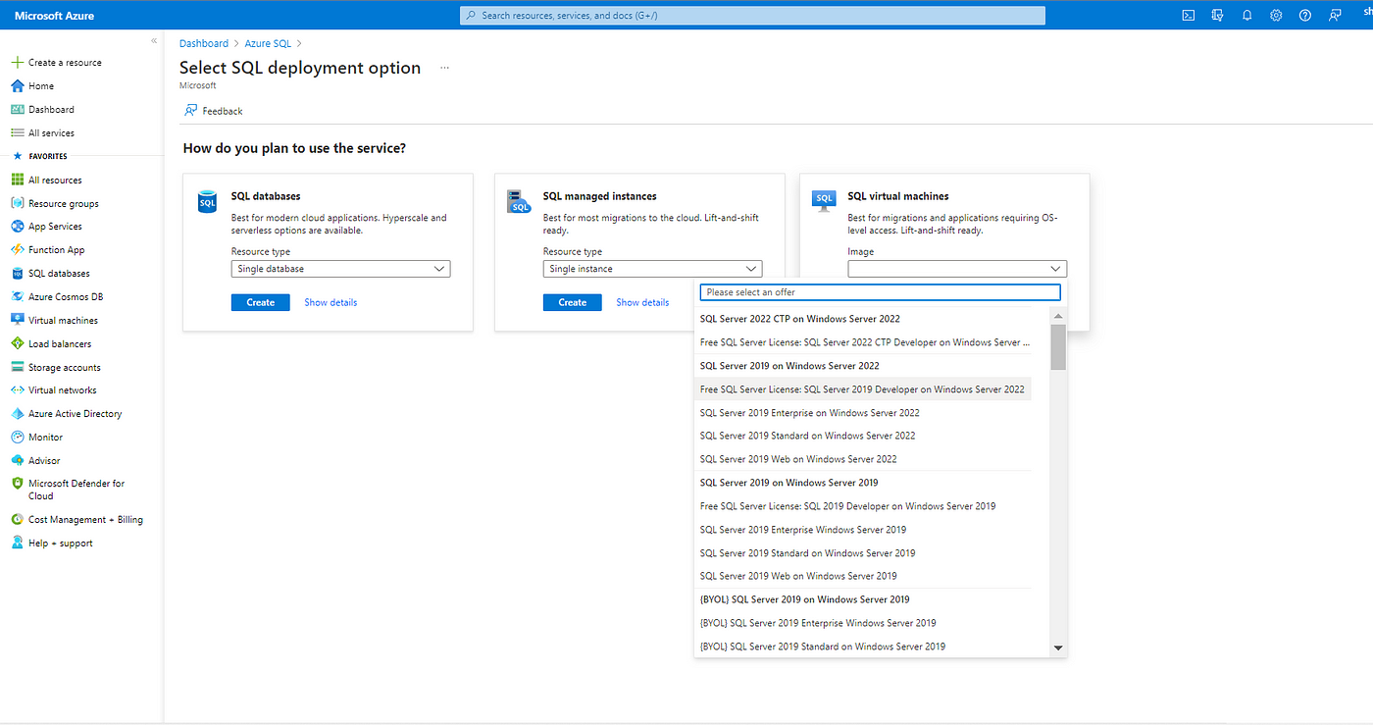
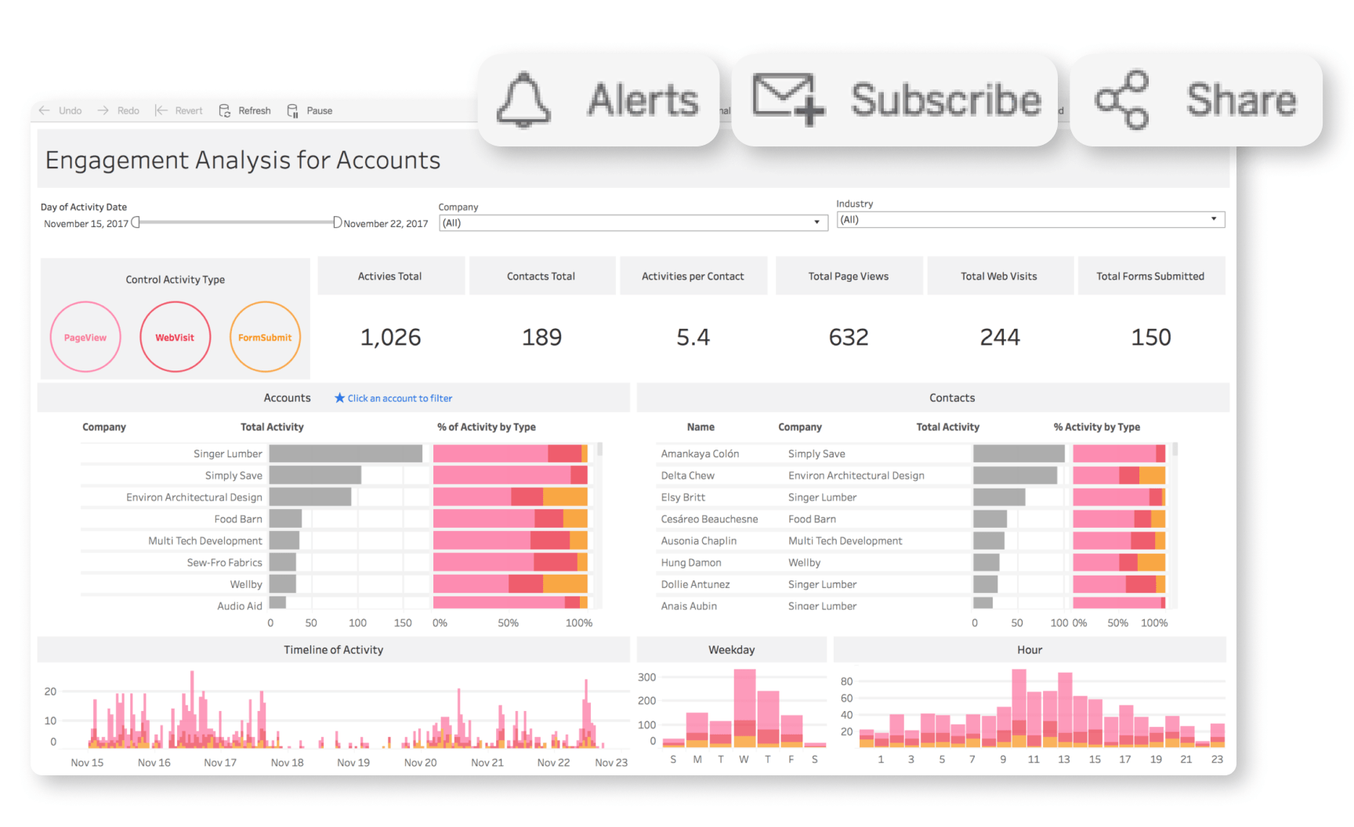
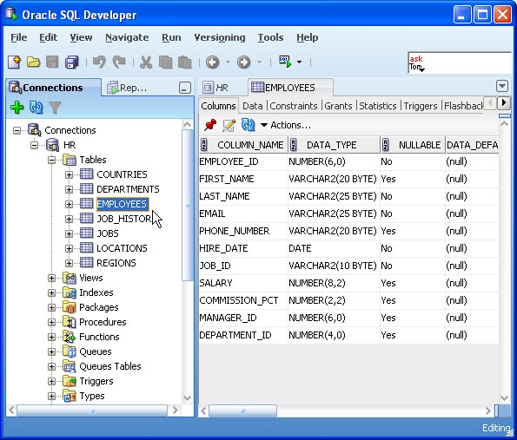
Scrum, Agile, QA/ QC
The daily scrum, also called the standup, is a short daily meeting designed to let the team plan out its work for the day and identify any obstacles that could impact that work. Most teams hold these meetings in the morning and limit them to 10 or 15 minutes.
Azure SQL VM

Slide 28
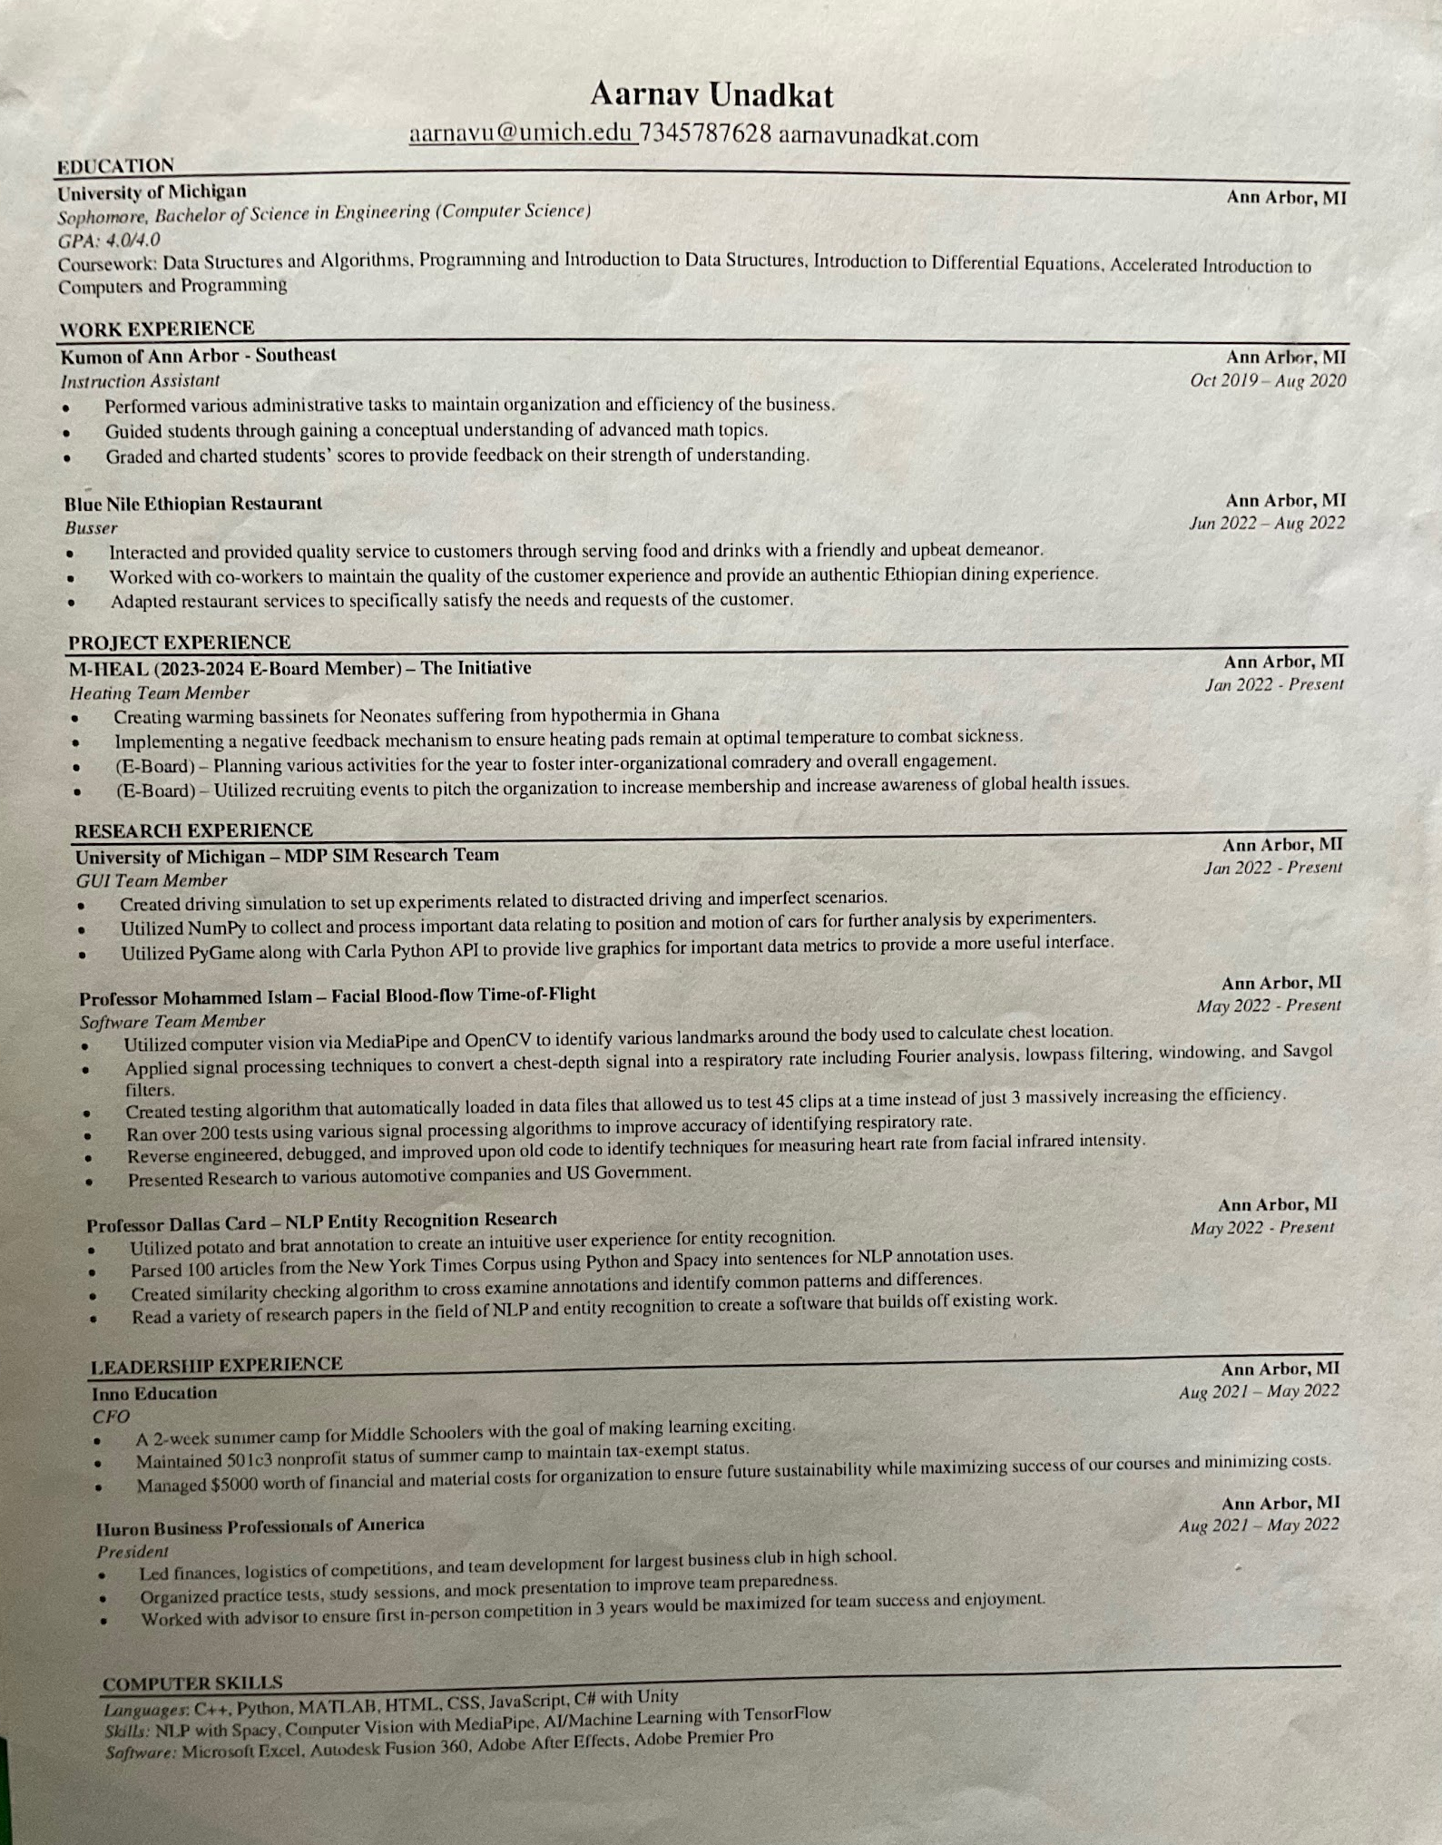
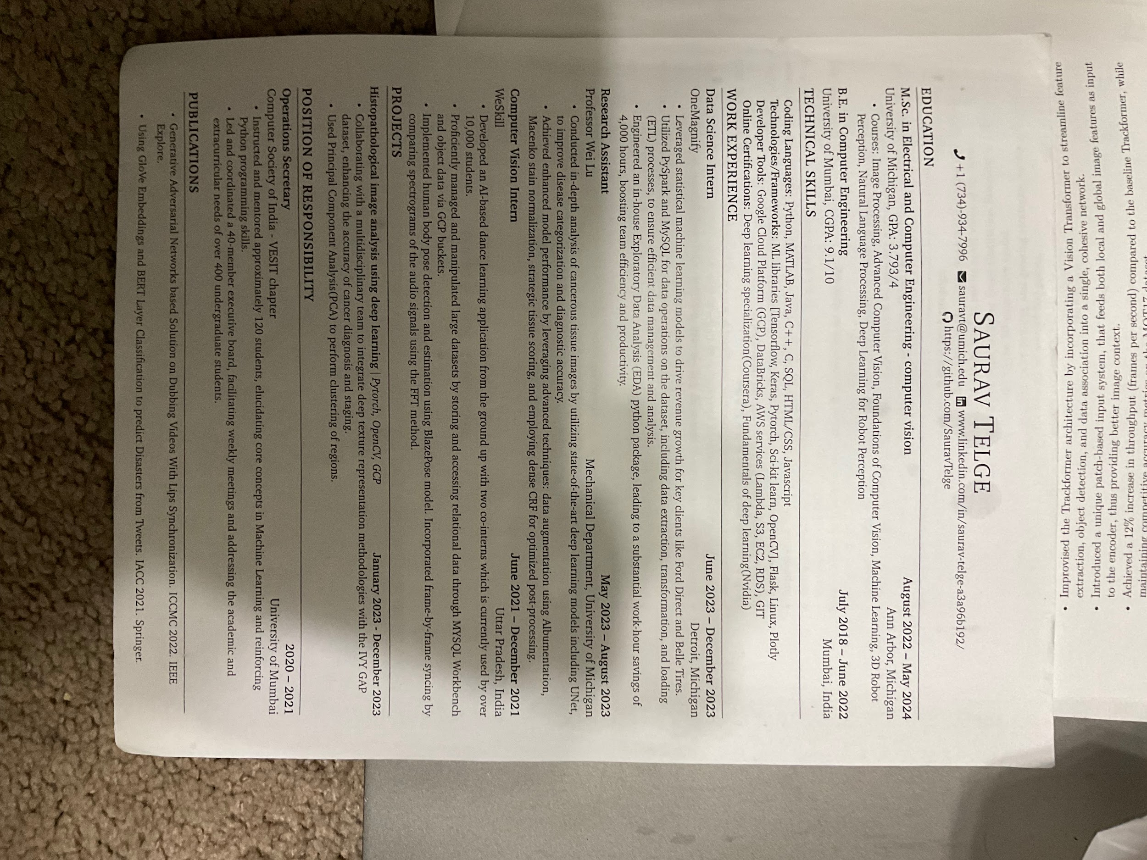
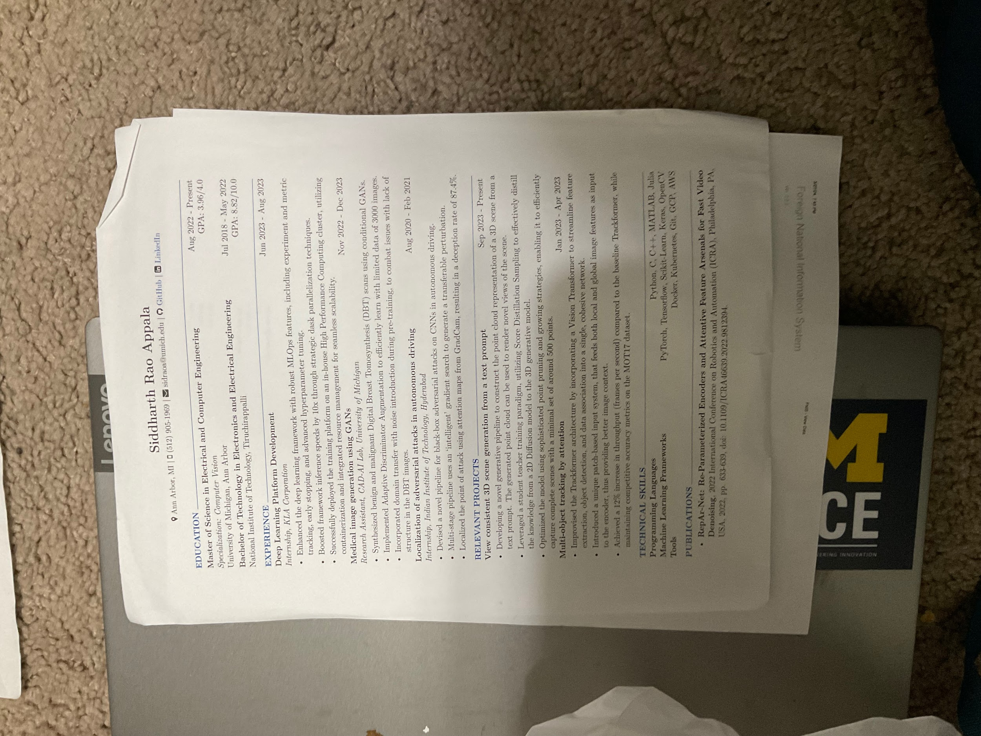

Slide 29
